Slide 1
Chapter 20
SHEET METALWORKING
Cutting Operations
Bending Operations
Drawing
Other Sheet Metal Forming Operations
Dies and Presses for Sheet Metal Processes
Sheet Metal Operations Not Performed on Presses
Bending of Tube Stock

Slide 2
Sheet Metalworking Defined
Cutting and forming operations performed on relatively thin sheets of metal
Thickness of sheet metal = 0.4 mm (1/64 in) to 6 mm (1/4 in)
Thickness of plate stock > 6 mm
Operations usually performed as cold working

Slide 3
Sheet and Plate Metal Products
Sheet and plate metal parts for consumer and industrial products such as
  Automobiles and trucks
  Airplanes
  Railway cars and locomotives
  Farm and construction equipment
  Small and large appliances
  Office furniture
  Computers and office equipment

Slide 4
Advantages of Sheet Metal Parts
High strength
Good dimensional accuracy
Good surface finish
Relatively low cost
For large quantities, economical mass production operations are available

Slide 5
Sheet Metalworking Terminology
“Punch‑and‑die”
  Tooling to perform cutting, bending, and drawing
“Stamping press”
  Machine tool that performs most sheet metal operations
“Stampings”
  Sheet metal products

Slide 6
Three Major Categories of
Sheet Metal Processes
Cutting
  Shearing to separate large sheets; or cut part perimeters or make holes in sheets
Bending
  Straining sheet around a straight axis
Drawing
  Forming of sheet into convex or concave shapes

Slide 7
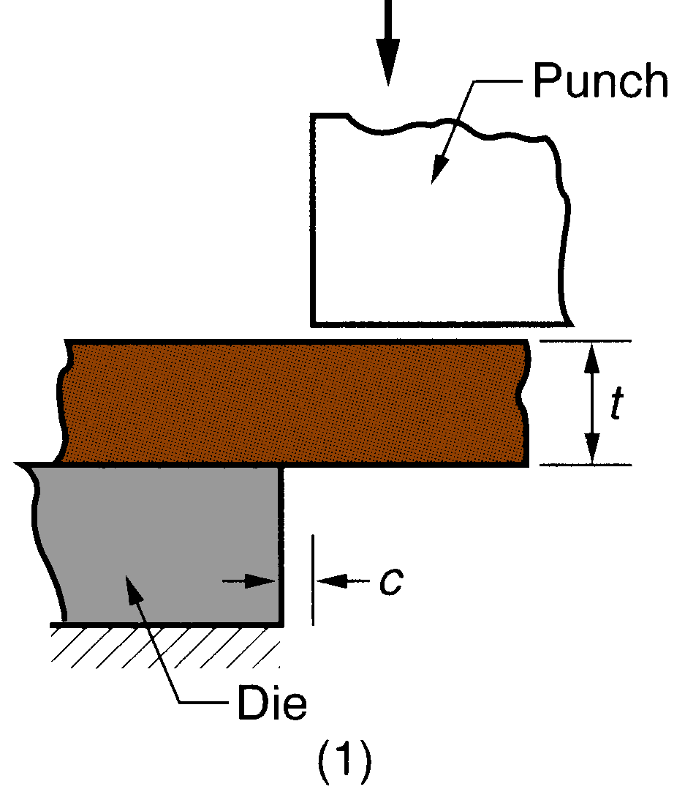
Cutting
Shearing between two sharp cutting edges
Figure 20.1 ‑ Shearing of sheet metal between two cutting edges:
(1) just before the punch contacts work

Slide 8
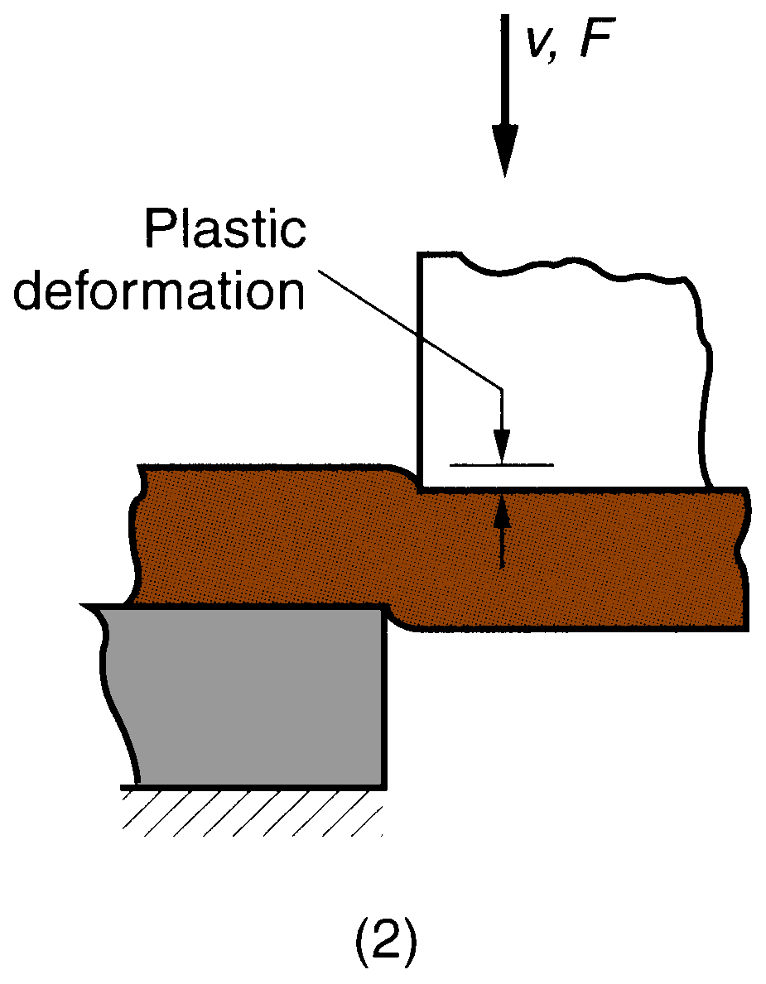
Figure 20.1 ‑ Shearing of sheet metal between two cutting edges:
(2) punch begins to push into work, causing plastic deformation

Slide 9
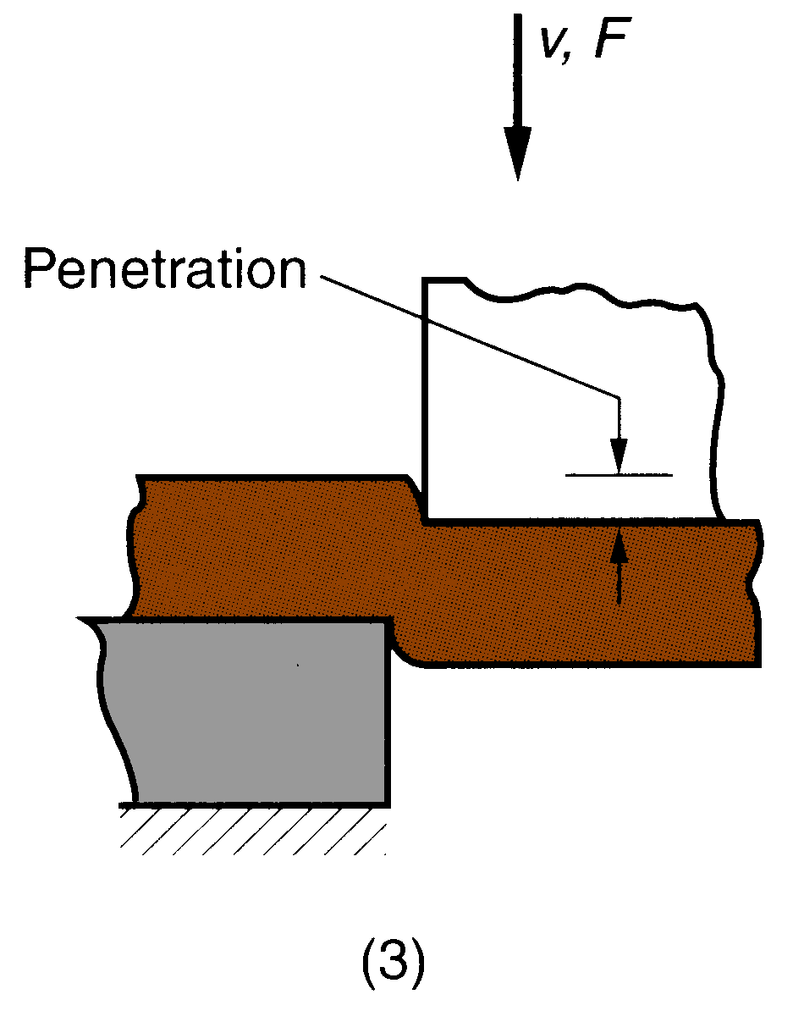
Figure 20.1 ‑ Shearing of sheet metal between two cutting edges:
(3) punch compresses and penetrates into work causing a smooth cut surface

Slide 10
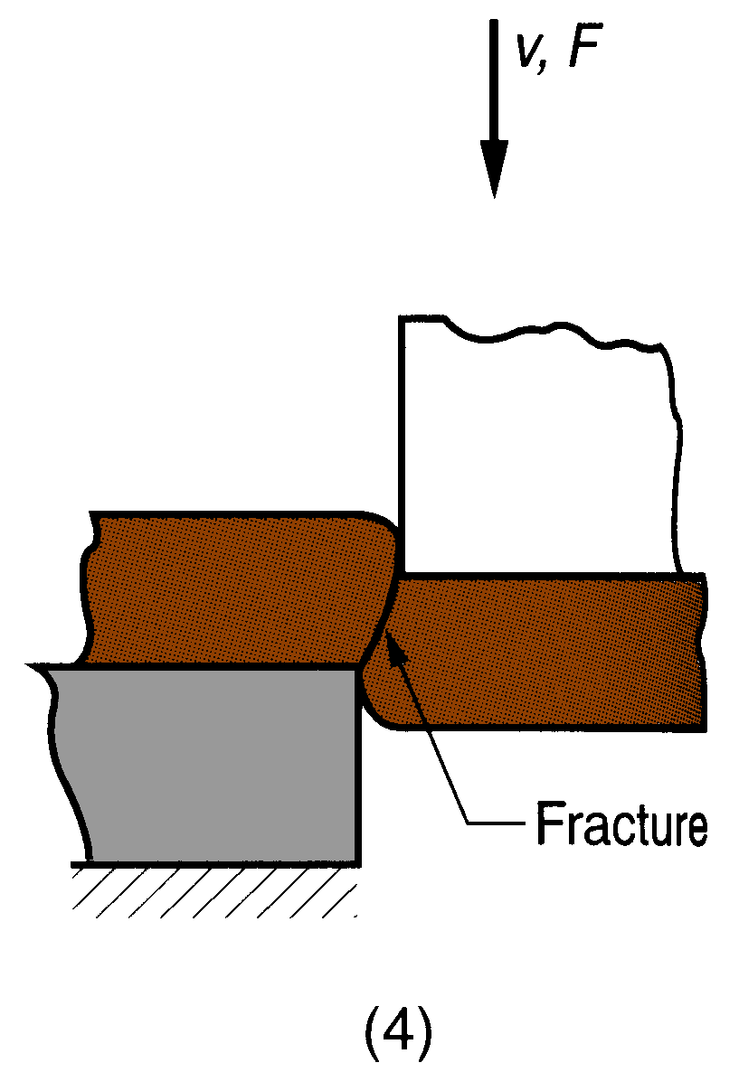
Figure 20.1 ‑ Shearing of sheet metal between two cutting edges:
(4) fracture is initiated at the opposing cutting edges which separates the sheet

Slide 11
Shearing, Blanking, and Punching
Three principal operations in pressworking that cut sheet metal:
Shearing
Blanking
Punching

Slide 12
Shearing
Sheet metal cutting operation along a straight line between two cutting edges
Typically used to cut large sheets into smaller sections for subsequent operations

Slide 13
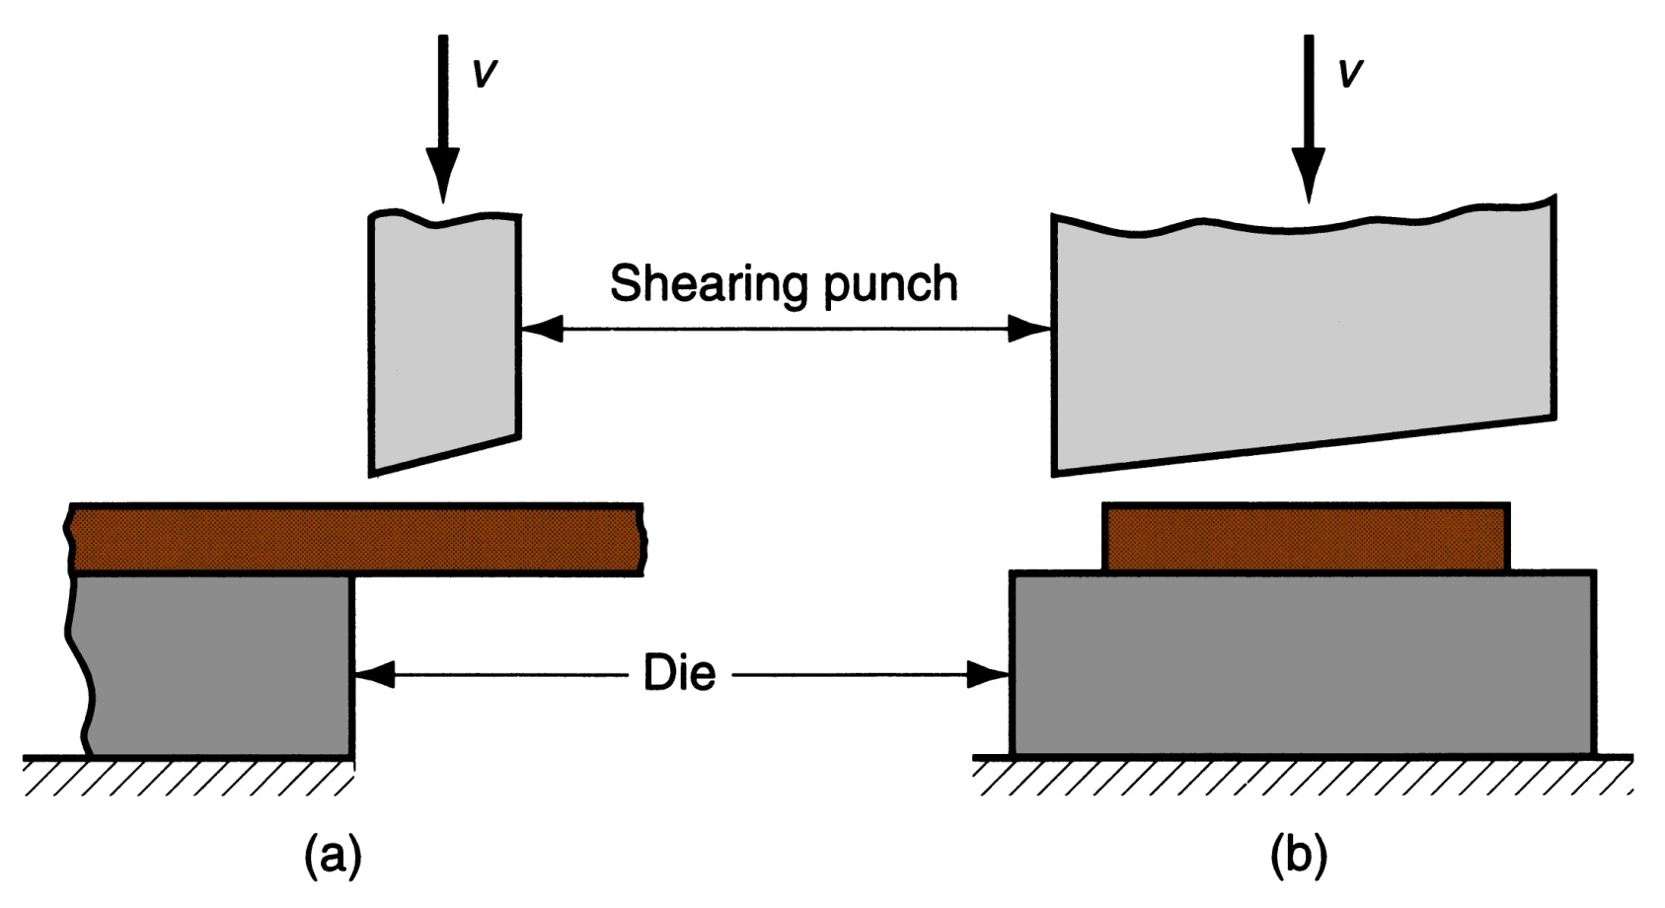
Figure 20.3 ‑ Shearing operation:
side view of the shearing operation
(b) front view of power shears equipped with inclined upper cutting blade Symbol v indicates motion

Slide 14
Blanking and Punching
Blanking - sheet metal cutting to separate piece from surrounding stock
Cut piece is the desired part, called a blank
Punching - sheet metal cutting similar to blanking except cut piece is scrap, called a slug
Remaining stock is the desired part

Slide 15
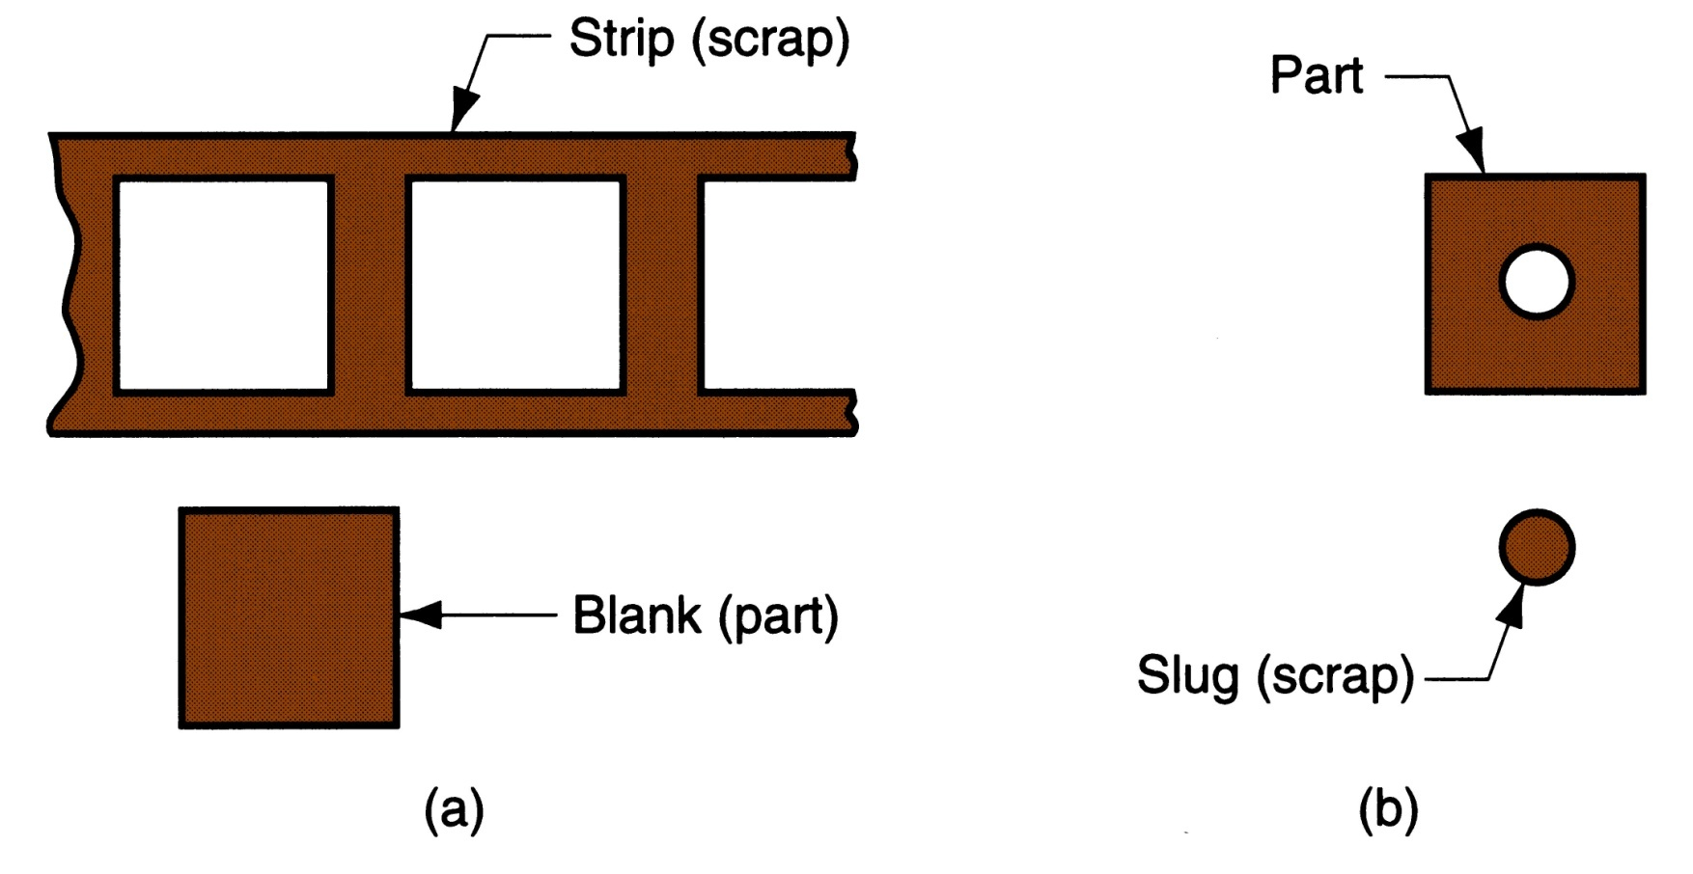
Figure 20.4 ‑ (a) Blanking and (b) punching

Slide 16
Clearance in Sheet Metal Cutting
Distance between the punch and die
Typical values range between 4% and 8% of stock thickness
  If too small, fracture lines pass each other, causing double burnishing and larger force
  If too large, metal is pinched between cutting edges and excessive burr results

Slide 17
Clearance in Sheet Metal Cutting
Recommended clearance can be calculated by:
c = at
  where c = clearance; a = allowance; and t = stock thickness
Allowance a is determined according to type of metal

Slide 18
Allowance a for
Three Sheet Metal Groups
Metal group | a
1100S and 5052S aluminum alloys, all tempers | 0.045
2024ST and 6061ST aluminum alloys; brass, soft cold rolled steel, soft stainless steel | 0.060
Cold rolled steel, half hard; stainless steel, half hard and full hard | 0.075

Slide 19
Punch and Die Sizes for
Blanking and Punching
For a round blank of diameter D_{b}:
  Blanking punch diameter = D_{b} ‑ 2c
  Blanking die diameter = D_{b}
  where c = clearance
For a round hole of diameter D_{h}:
  Hole punch diameter = D_{h}
  Hole die diameter = D_{h} + 2c
  where c = clearance

Slide 20
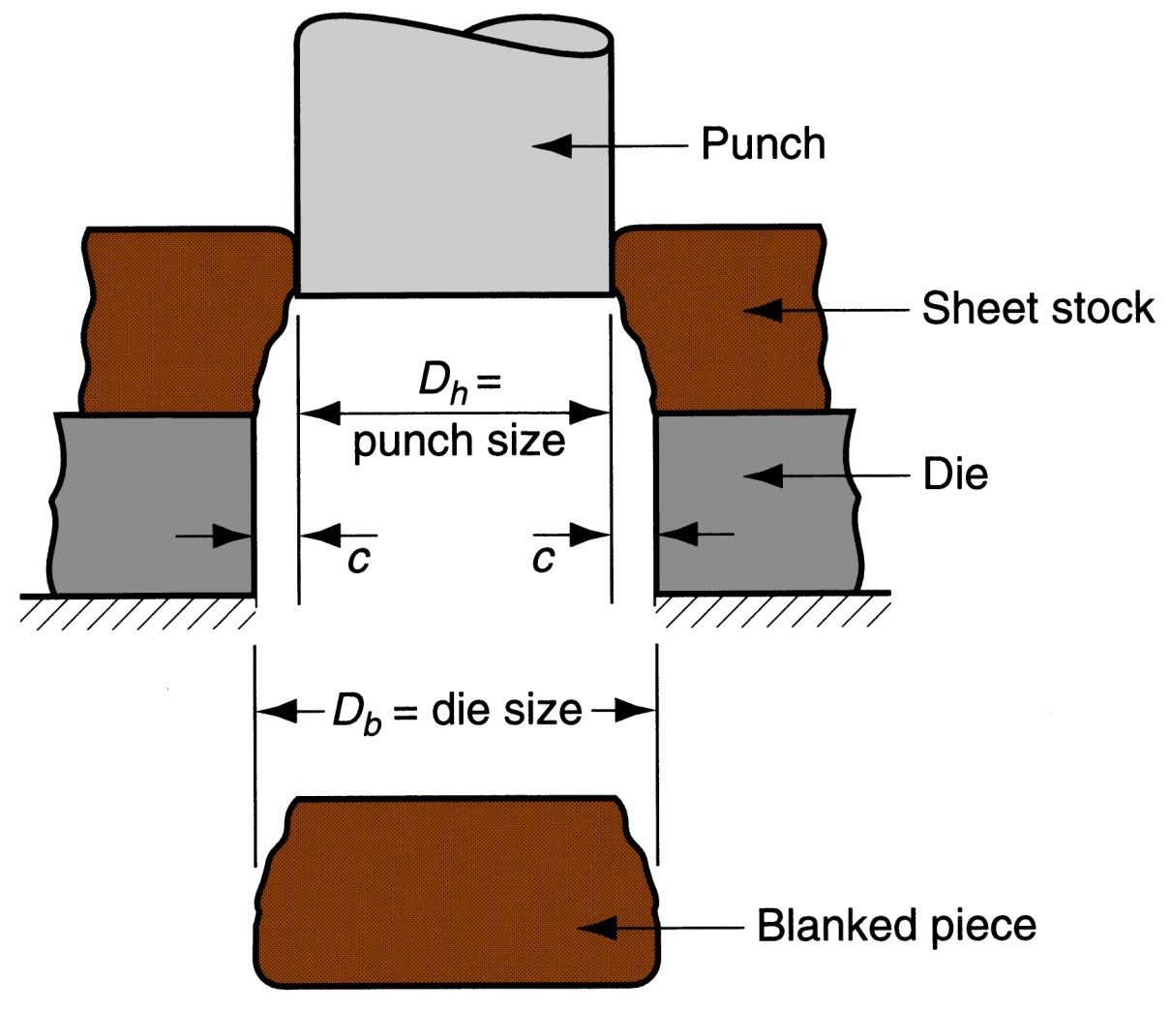
Figure 20.6 ‑ Die size determines blank size D_{b}; punch size determines hole size D_{h}.; c = clearance

Slide 21
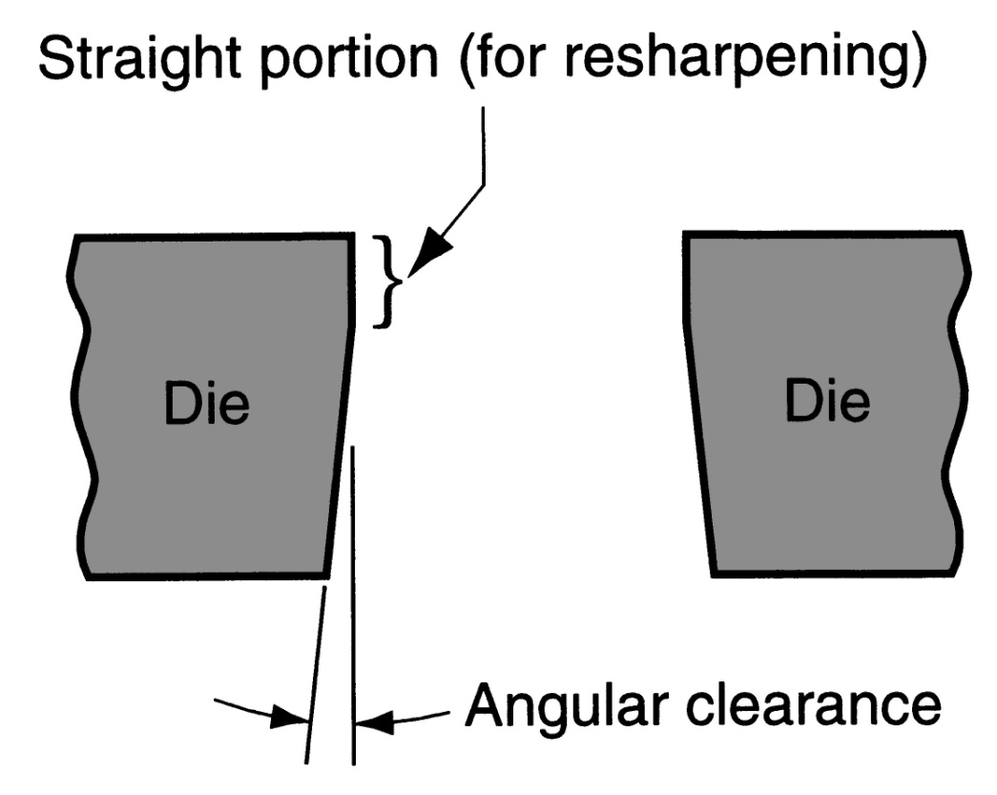
Angular Clearance
Purpose: allows slug or blank to drop through die
Typical values: 0.25° to 1.5° on each side
Figure 20.7 ‑ Angular clearance

Slide 22
Cutting Forces
Important for determining press size (tonnage)
    F = S t L
where S = shear strength of metal; t = stock thickness, and L = length of cut edge

Slide 23
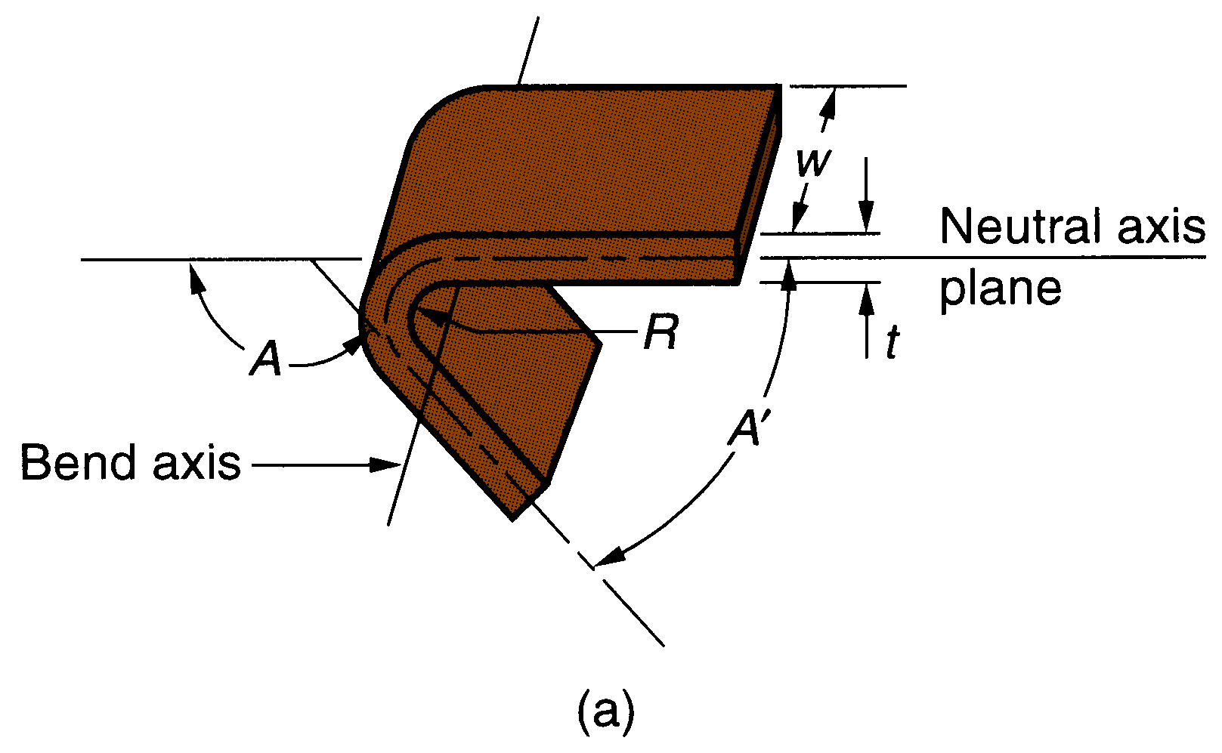
Bending
Straining sheetmetal around a straight axis to take a permanent bend
Figure 20.11 ‑ (a) Bending of sheet metal

Slide 24
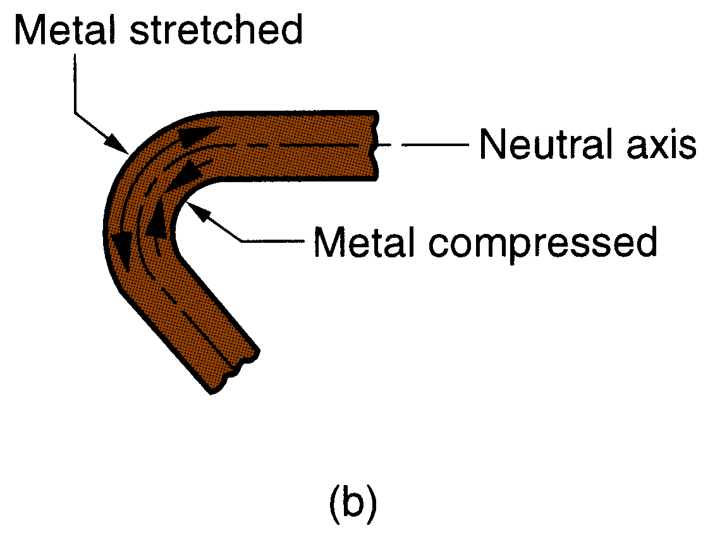
Metal on inside of neutral plane is compressed, while metal on outside of neutral plane is stretched
Figure 20.11 ‑ (b) both compression and tensile elongation of the metal occur in bending

Slide 25
Types of Sheetmetal Bending
V‑bending - performed with a V‑shaped die
Edge bending - performed with a wiping die

Slide 26
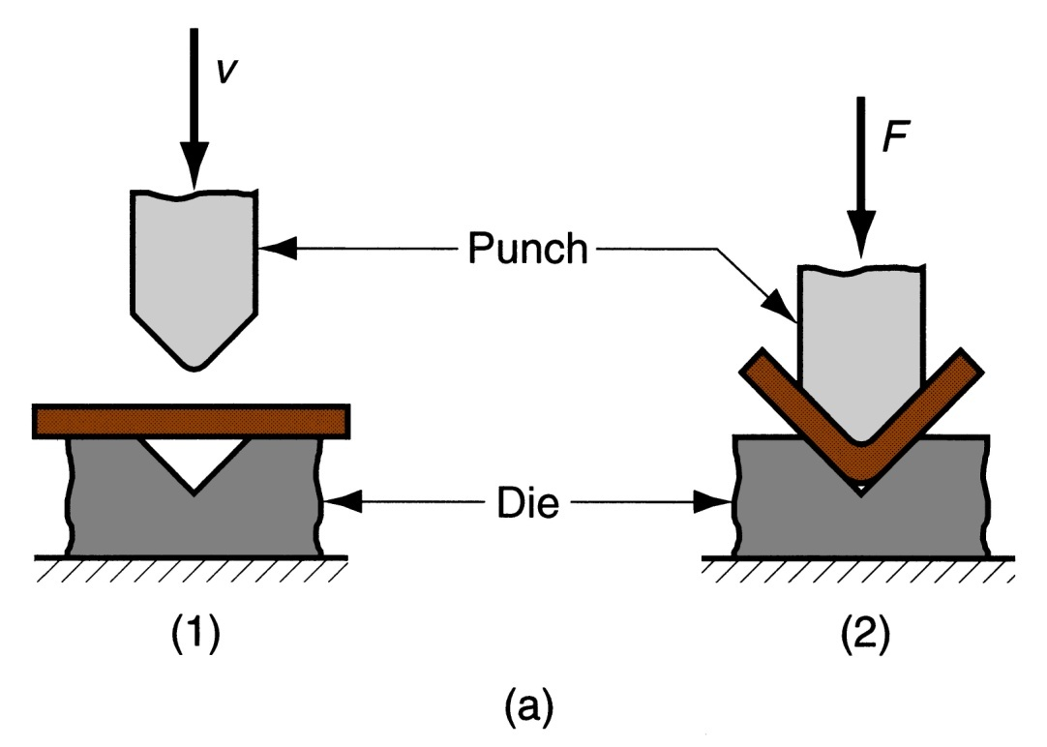
V-Bending
For low production
Performed on a press brake
V-dies are simple and inexpensive
Figure 20.12 ‑
(a) V‑bending

Slide 27
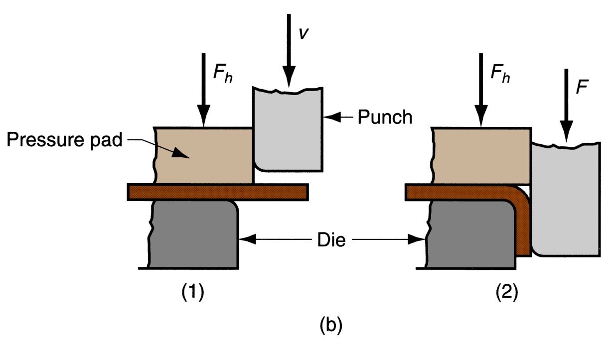
Edge Bending
For high production
Pressure pad required
Dies are more complicated and costly
Figure 20.12 ‑ (b) edge bending

Slide 28
Stretching during Bending
If bend radius is small relative to stock thickness, metal tends to stretch during bending
Important to estimate amount of stretching, so that final part length = specified dimension
Problem: to determine the length of neutral axis of the part before bending

Slide 29
Bend Allowance Formula
where BA = bend allowance; A = bend angle; R= bend radius; t = stock thickness; and K_{ba} is factor to estimate stretching
If R < 2t, K_{ba} = 0.33
If R ≥ 2t, K_{ba} = 0.50

Slide 30
Springback in Bending
Springback = increase in included angle of bent part relative to included angle of forming tool after tool is removed
Reason for springback:
  When bending pressure is removed, elastic energy remains in bent part, causing it to recover partially toward its original shape

Slide 31
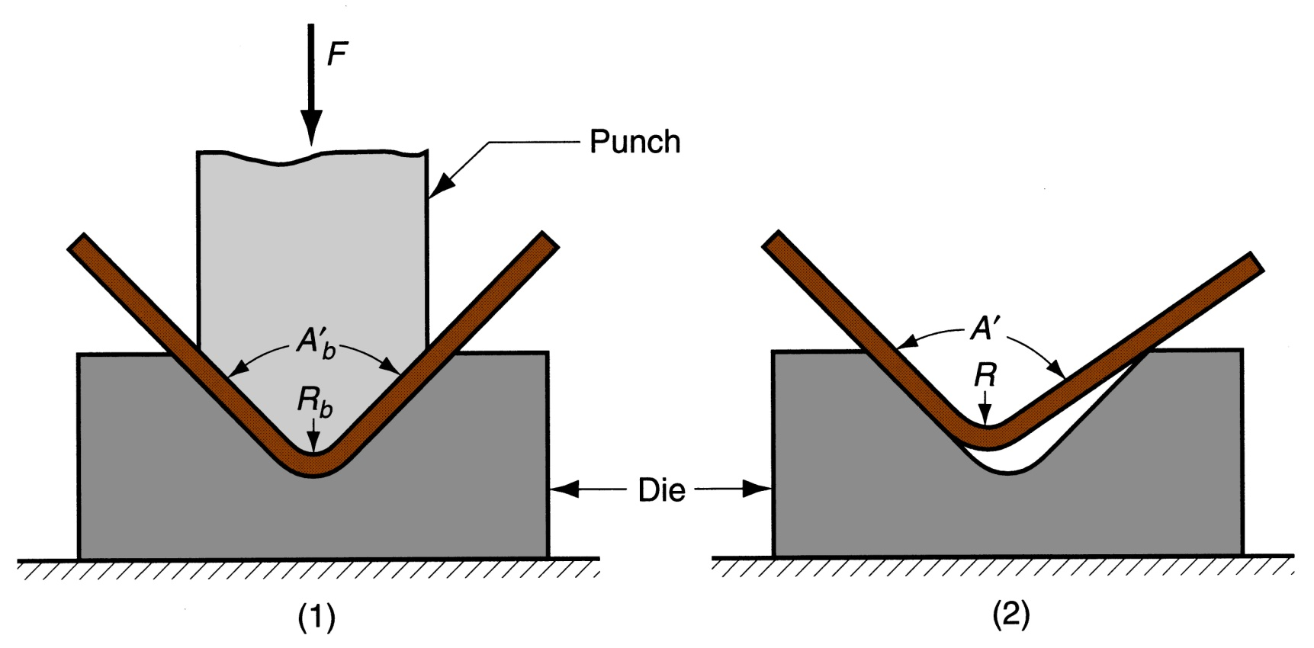
Figure 20.13 ‑ Springback in bending shows itself as a decrease in bend angle and an increase in bend radius: (1) during bending, the work is forced to take the radius R_{b} and included angle A_{b}' of the bending tool (punch in V‑bending), (2) after punch is removed, the work springs back to radius R and angle A'

Slide 32
Bending Force
Maximum bending force estimated as follows:
where F = bending force; TS = tensile strength of sheet metal; w = part width in direction of bend axis; and t = stock thickness. For V- bending, K_{bf} = 1.33; for edge bending, K_{bf} = 0.33

Slide 33
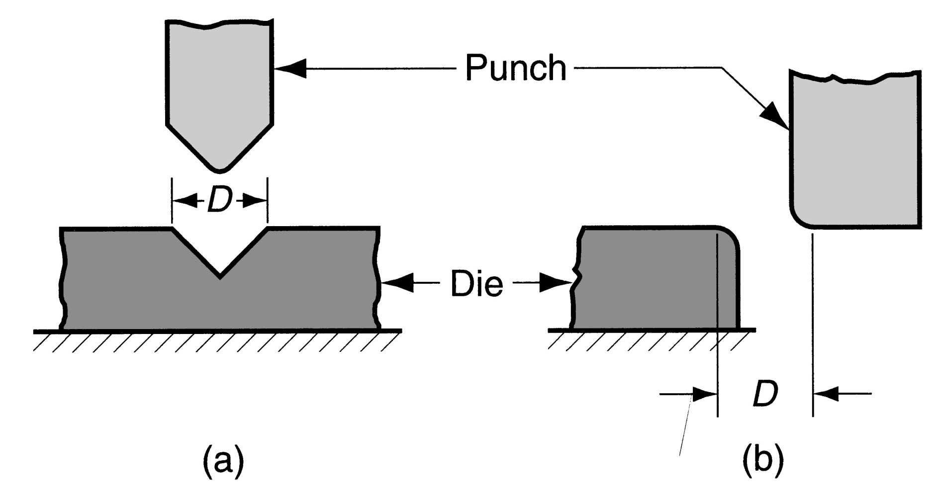
Figure 20.14 ‑ Die opening dimension D: (a) V‑die, (b) wiping die

Slide 34
Drawing
Sheet metal forming to make cup‑shaped, box‑shaped, or other complex‑curved, hollow‑shaped parts
Sheet metal blank is positioned over die cavity and then punch pushes metal into opening
Products: beverage cans, ammunition shells, automobile body panels

Slide 35
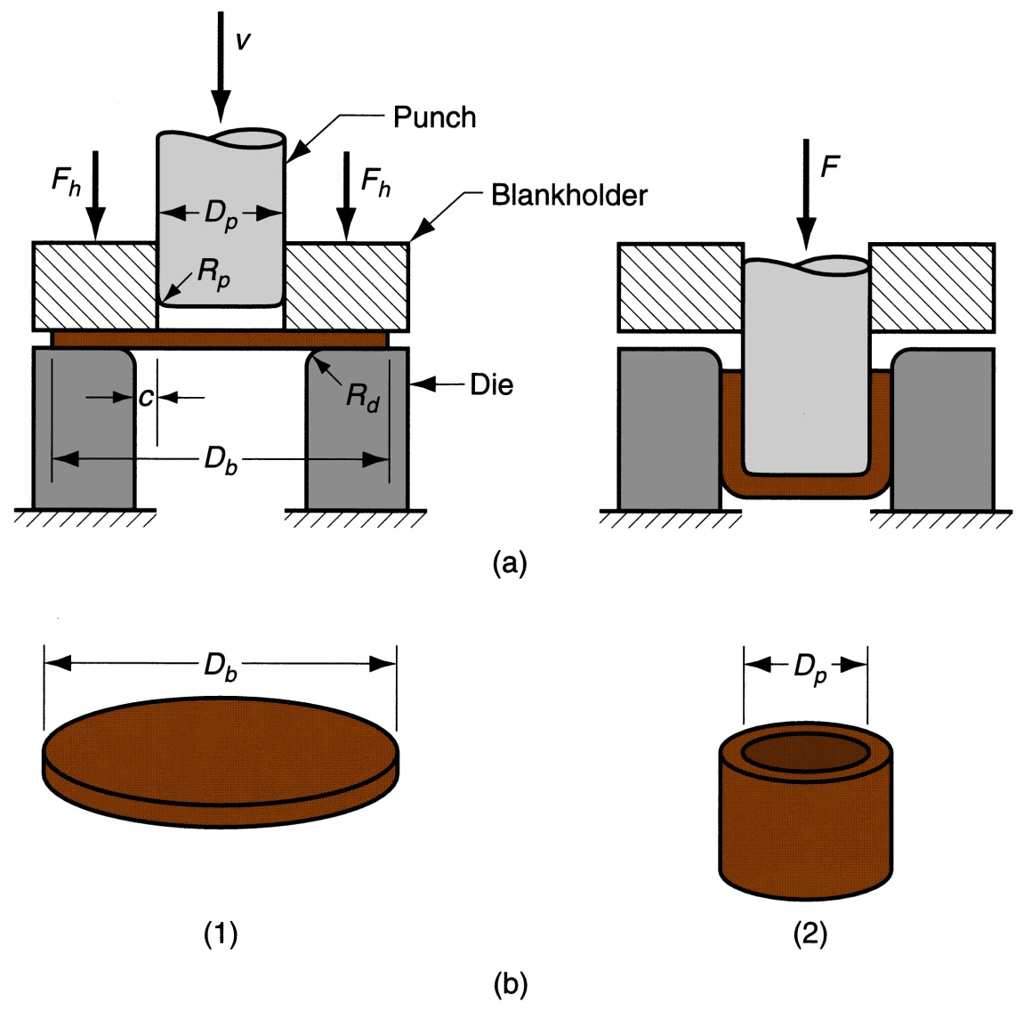
Figure 20.19 ‑
Drawing of a cup‑shaped part:
start of operation before punch contacts work
near end of stroke
(b) Corresponding workpart:
(1) starting blank
(2) drawn part

Slide 36
Clearance in Drawing
Sides of punch and die separated by a clearance c given by:
c = 1.1 t
  where t = stock thickness
In other words, clearance = about 10% greater than stock thickness

Slide 37
Drawing Ratio DR
Most easily defined for cylindrical shape:
where D_{b} = blank diameter; and D_{p} = punch diameter
Indicates severity of a given drawing operation
  Upper limit = 2.0

Slide 38
Reduction r
Again, defined for cylindrical shape:
Value of r should be less than 0.50

Slide 39
Thickness‑to‑Diameter Ratio
Thickness of starting blank divided by blank diameter
Thickness-to-diameter ratio = t/D_{b}
Desirable for t/D_{b} ratio to be greater than 1%
As t/D_{b} decreases, tendency for wrinkling increases

Slide 40
Blank Size Determination
For final dimensions of drawn shape to be correct, starting blank diameter D_{b} must be right
Solve for D_{b} by setting starting sheet metal blank volume = final product volume
To facilitate calculation, assume negligible thinning of part wall

Slide 41
Shapes other than Cylindrical Cups
Square or rectangular boxes (as in sinks),
Stepped cups,
Cones,
Cups with spherical rather than flat bases,
Irregular curved forms (as in automobile body panels)
Each of these shapes presents its own unique technical problems in drawing

Slide 42
Other Sheet Metal Forming on Presses
Other sheet metal forming operations performed on conventional presses
Operations performed with metal tooling
Operations performed with flexible rubber tooling

Slide 43
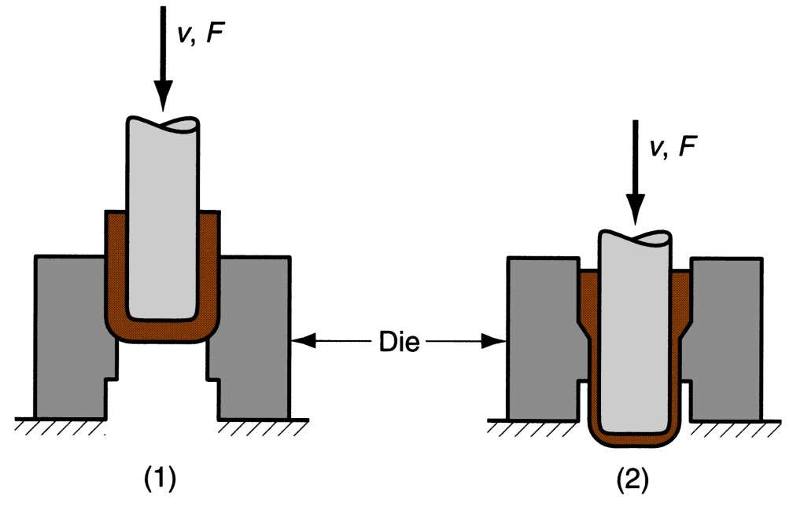
Ironing
Makes wall thickness of cylindrical cup more uniform
Examples: beverage cans and artillery shells
Figure 20.25 ‑ Ironing to achieve a more uniform wall thickness in a drawn cup: (1) start of process; (2) during process
Note thinning and elongation of walls

Slide 44
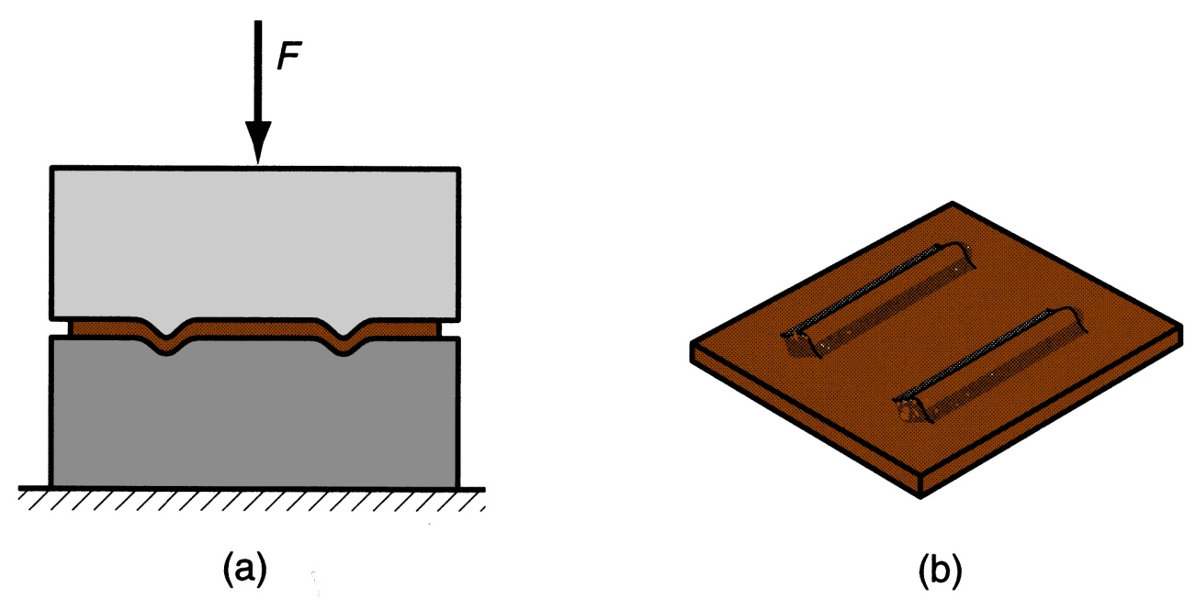
Embossing
Used to create indentations in sheet, such as raised (or indented) lettering or strengthening ribs
Figure 20.26 ‑ Embossing: (a) cross‑section of punch and die configuration during pressing; (b) finished part with embossed ribs

Slide 45
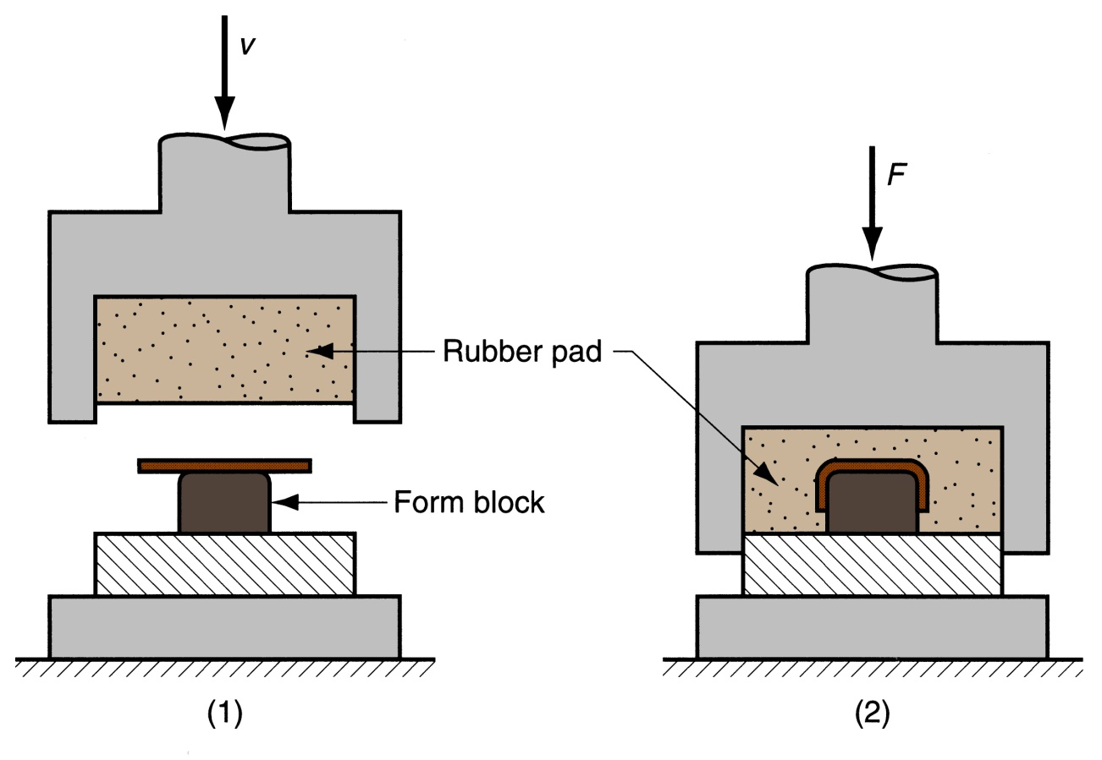
Guerin Process
Figure 20.28 ‑ Guerin process: (1) before and (2) after
Symbols v and F indicate motion and applied force respectively

Slide 46
Advantages of Guerin Process
Low tooling cost
Form block can be made of wood, plastic, or other materials that are easy to shape
Rubber pad can be used with different form blocks
Process attractive in small quantity production

Slide 47
Dies for Sheet Metal Processes
Most pressworking operations performed with conventional punch‑and‑die tooling
Custom‑designed for particular part
The term stamping die sometimes used for high production dies

Slide 48
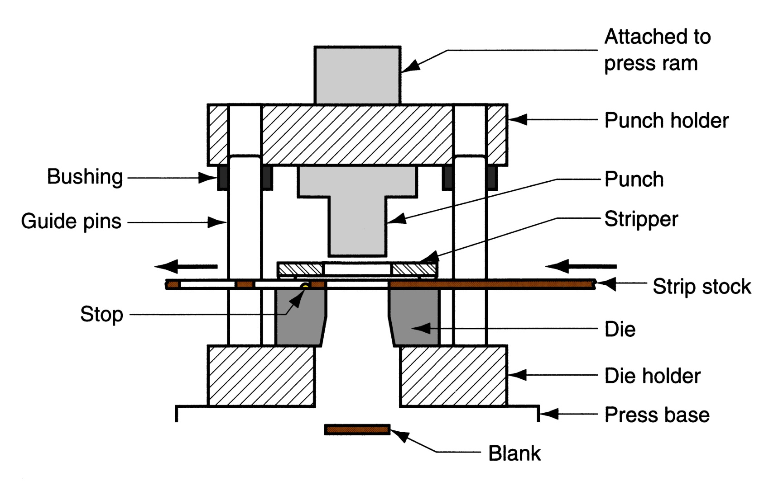
Figure 20.30 ‑ Components of a punch and die for a blanking operation

Slide 49
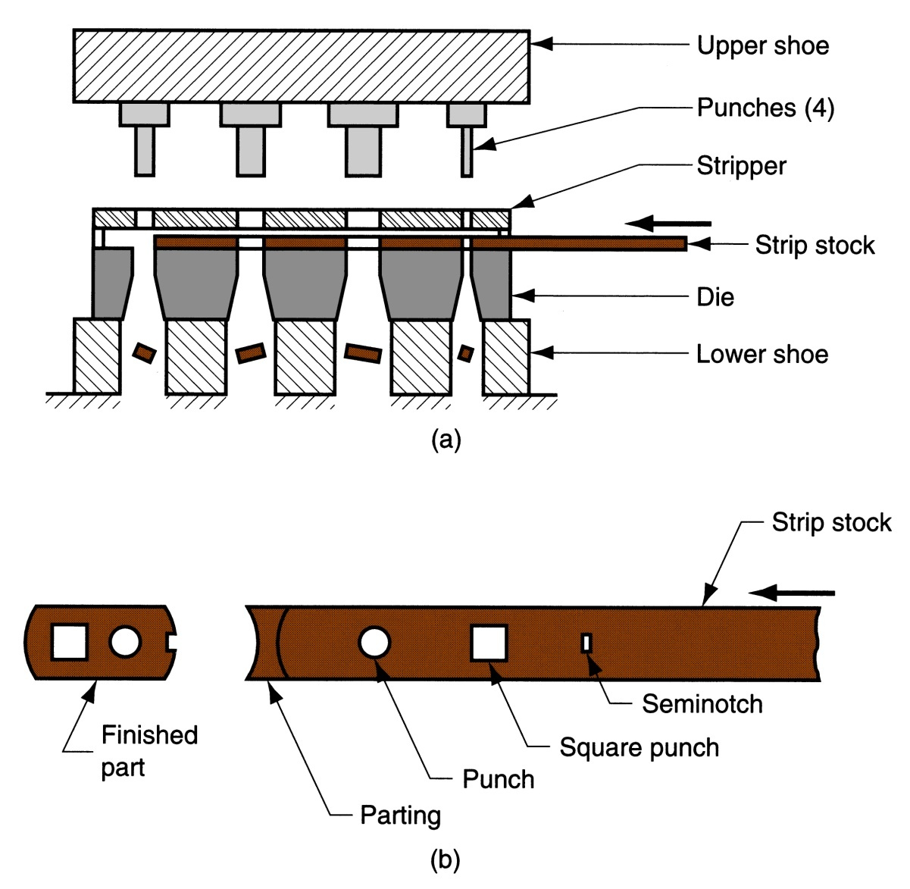
Figure 20.31 ‑
Progressive die;
associated strip development

Slide 50
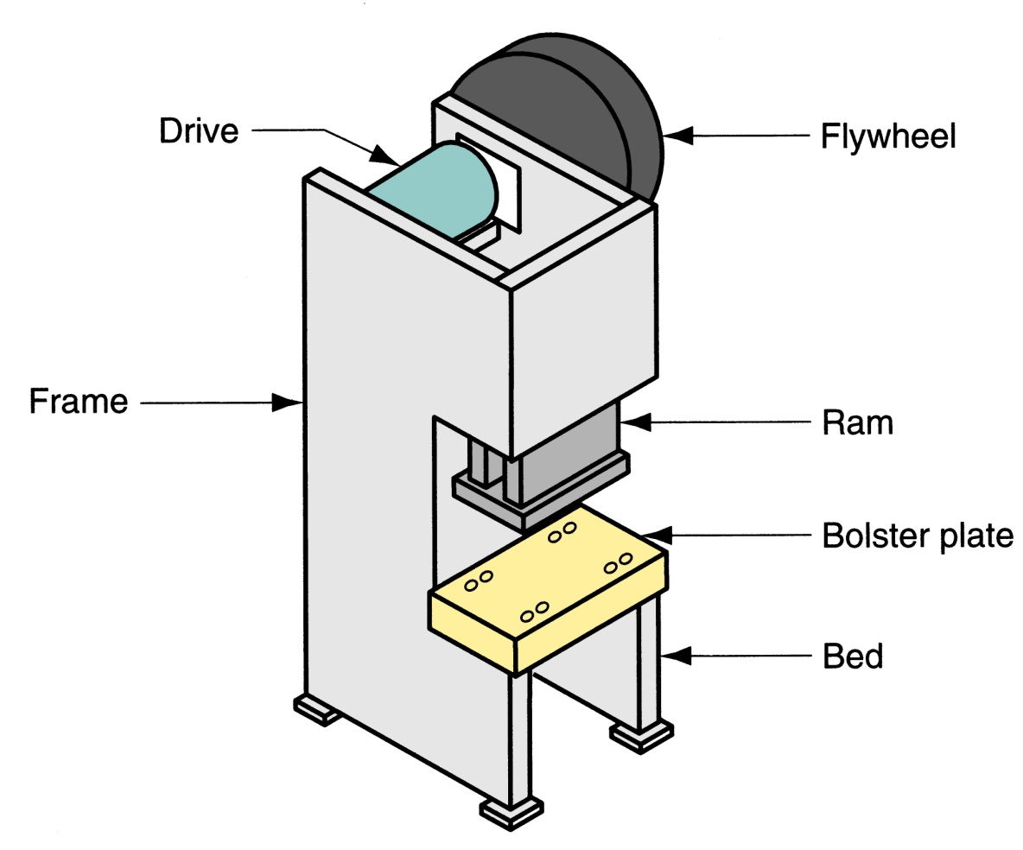
Figure 20.32 ‑ Components of a typical mechanical drive stamping press

Slide 51
Types of Stamping Press Frame
Gap frame – configuration of the letter C and often referred to as a C‑frame
Straight‑sided frame – box-like construction for higher tonnage

Slide 52
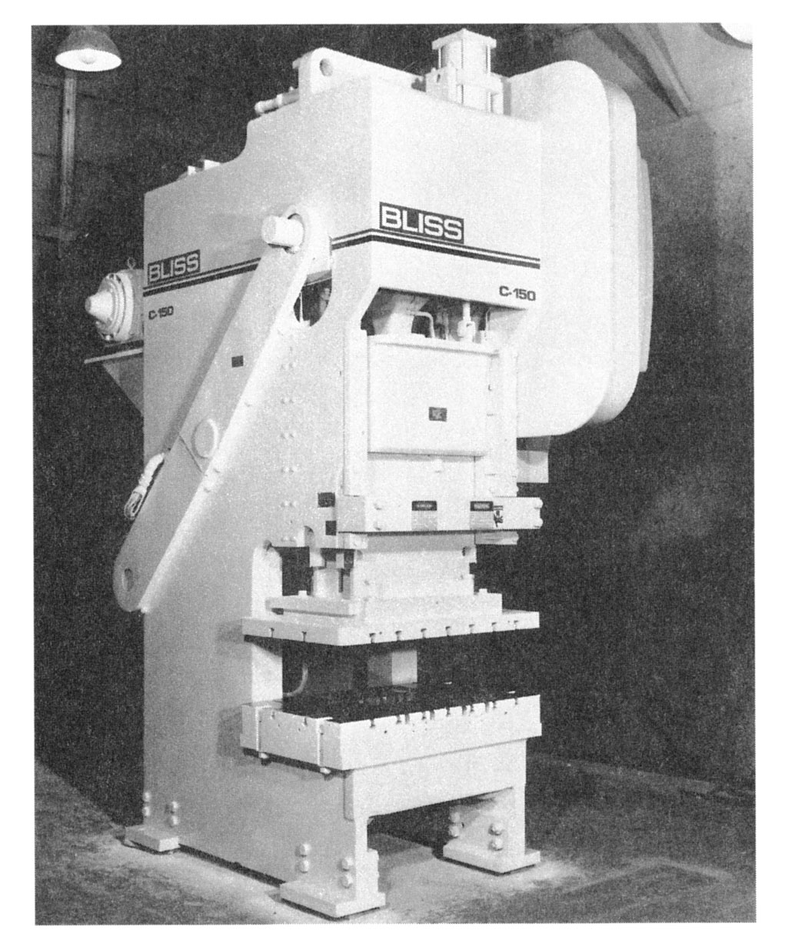
Figure 20.33 ‑ Gap frame press for sheet metalworking
(photo courtesy of E. W. Bliss Company)
Capacity = 1350 kN (150 tons)

Slide 53
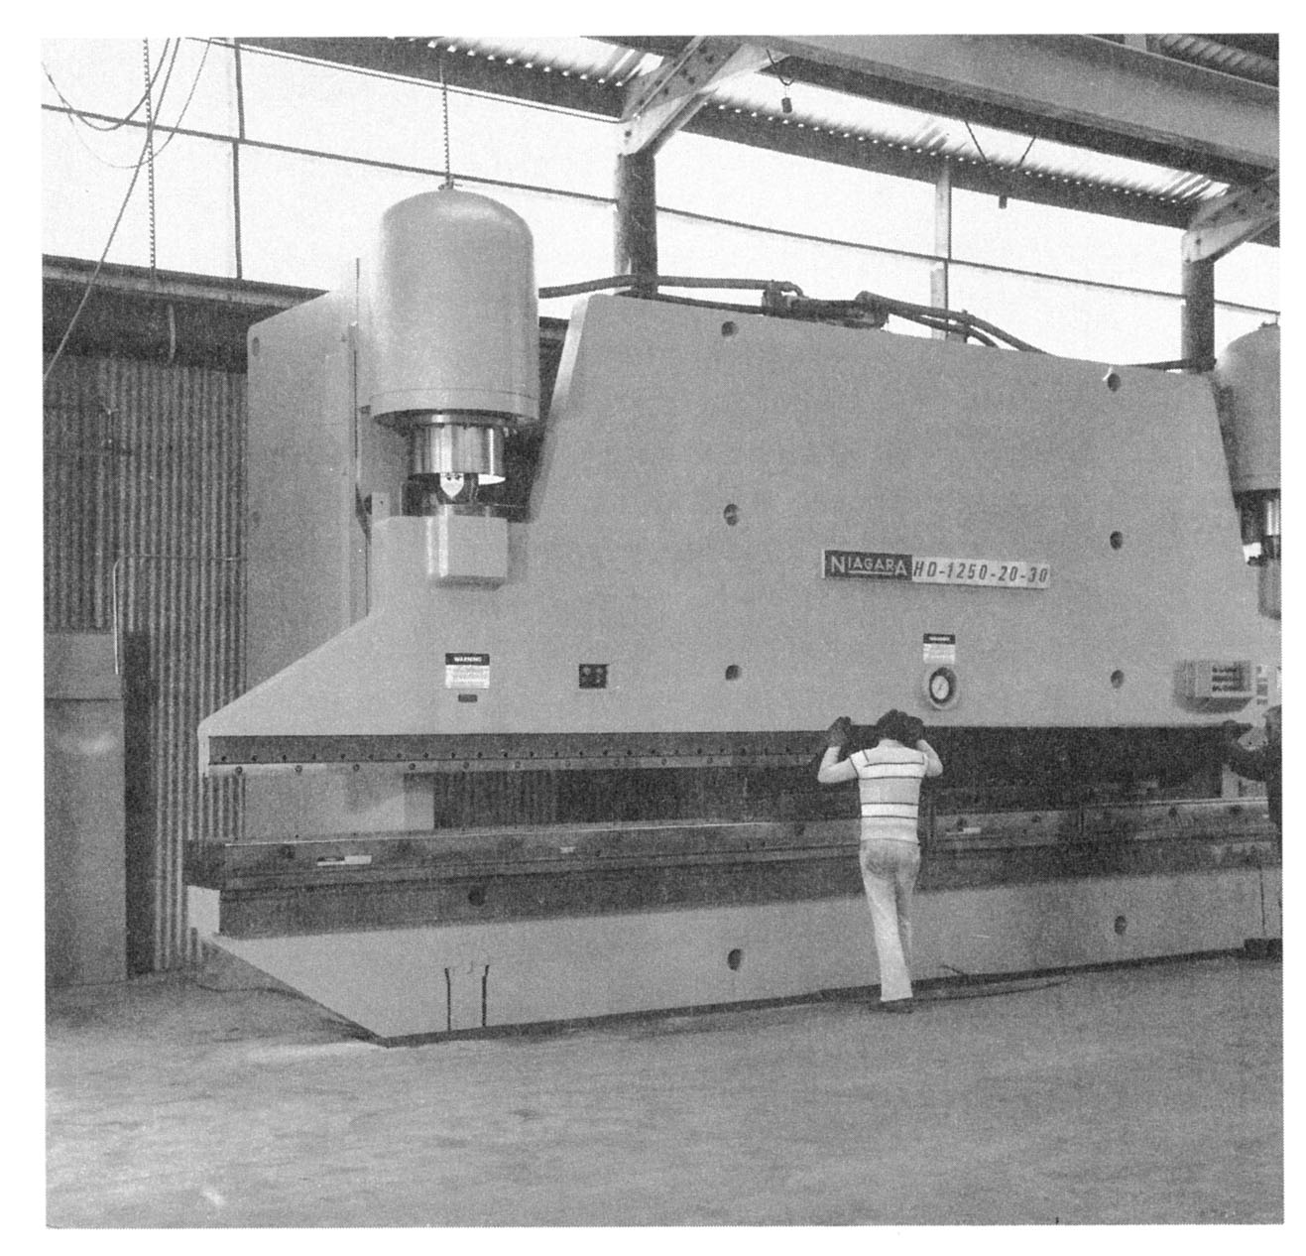
Figure 20.34 ‑
Press brake with bed width of 9.15 m (30 ft) and capacity of 11,200 kN (1250 tons); two workers are positioning plate stock for bending
(photo courtesy of Niagara Machine & Tool Works)

Slide 54
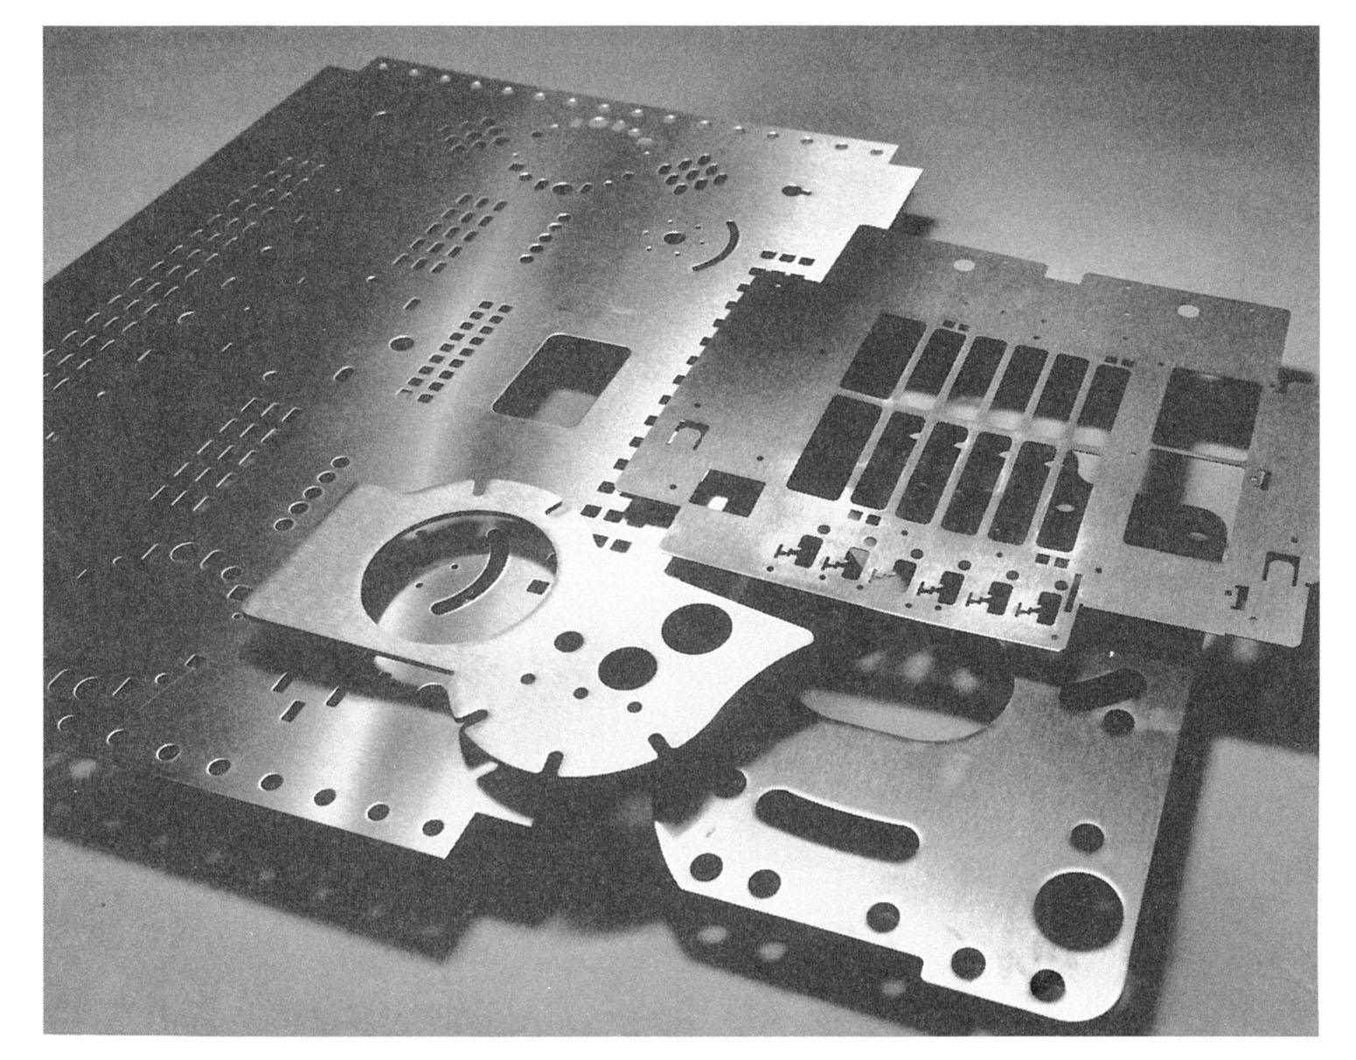
Figure 20.35 ‑ Several sheet metal parts produced on a turret press, showing variety of hole shapes possible
(photo courtesy of Strippet, Inc.)

Slide 55
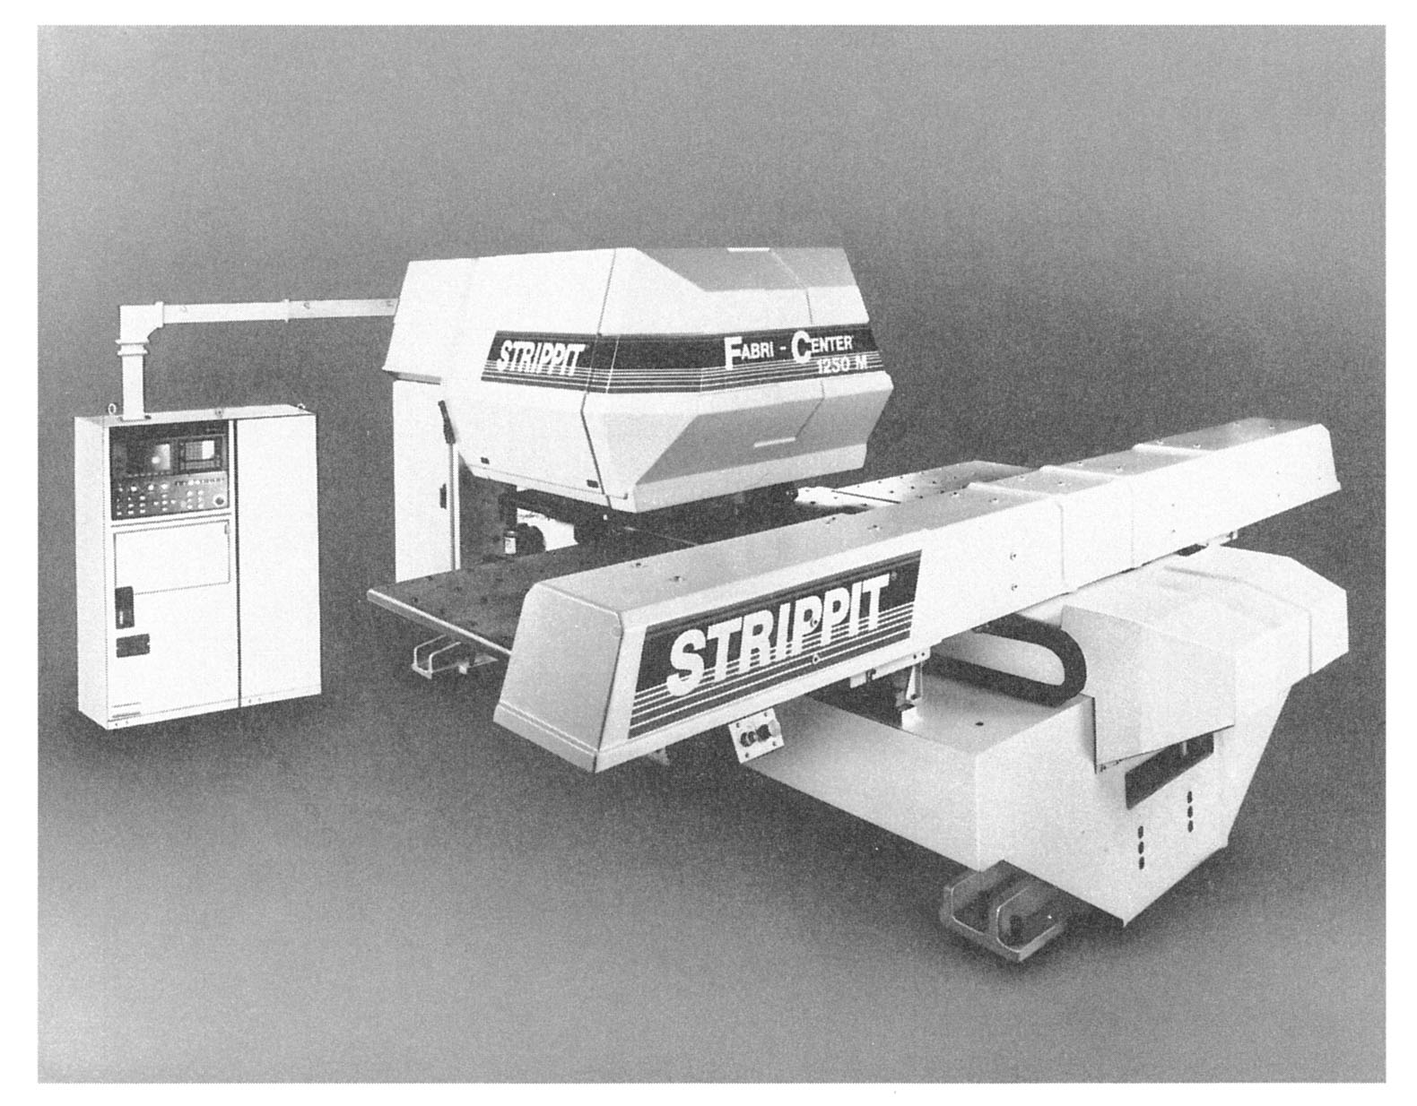
Figure 20.36 ‑ Computer numerical control turret press
(photo courtesy of Strippet, Inc.)

Slide 56
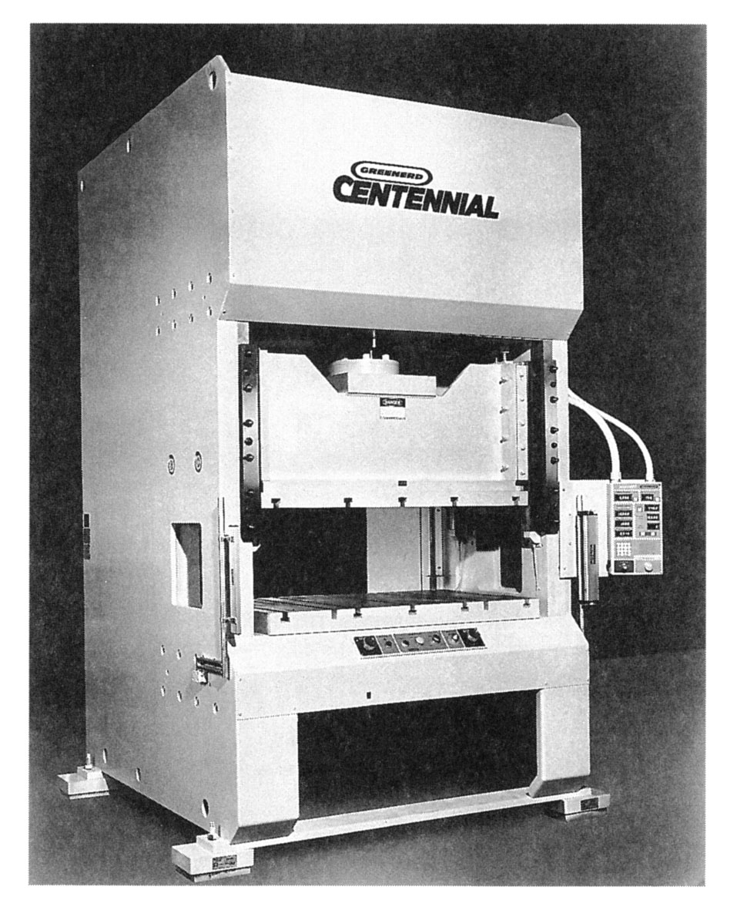
Figure 20.37 ‑
Straight‑sided frame press
(photo courtesy Greenerd Press & Machine Company, Inc.)

Slide 57
Power and Drive Systems
Hydraulic presses - use a large piston and cylinder to drive the ram
  Longer ram stroke than mechanical types
  Suited to deep drawing
  Slower than mechanical drives
Mechanical presses – convert rotation of motor to linear motion of ram
  High forces at bottom of stroke
  Suited to blanking and punching

Slide 58
Sheet Metal Operations
Not Performed on Presses
Stretch forming
Roll bending and forming
Spinning
High‑energy‑rate forming processes.

Slide 59
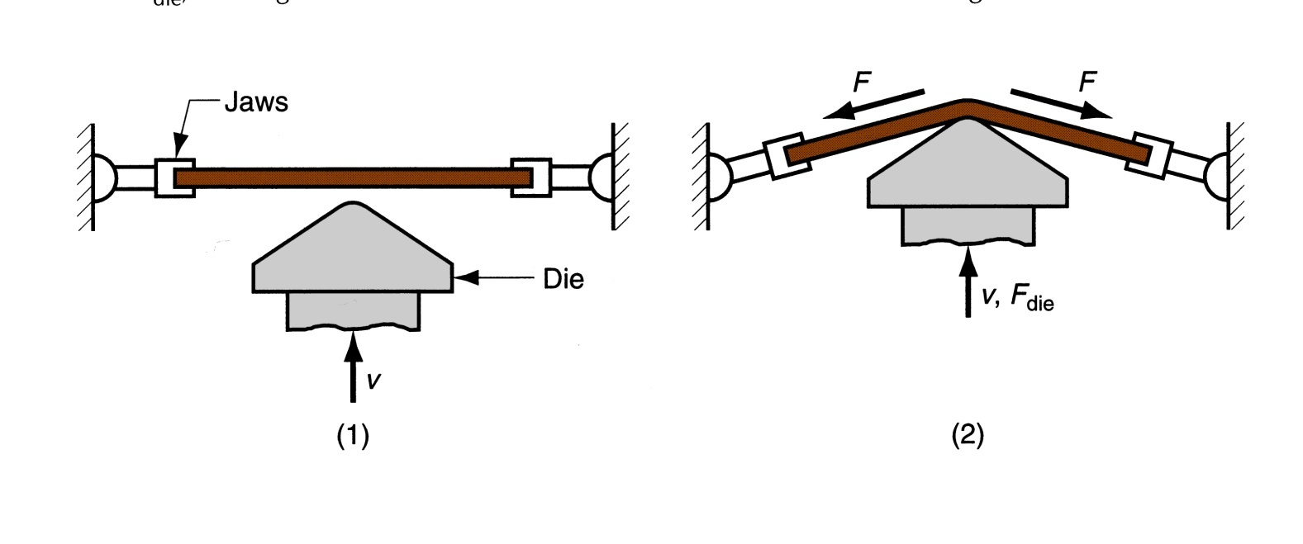
Stretch Forming
Sheet metal is stretched and simultaneously bent to achieve shape change
Figure 20.39 ‑ Stretch forming: (1) start of process; (2) form die is pressed into the work with force F_{die}, causing it to be stretched and bent over the form. F = stretching force

Slide 60
Force Required in Stretch Forming
where F = stretching force; L = length of sheet in direction perpendicular to stretching; t = instantaneous stock thickness; and Y_{f} = flow stress of work metal
Die force F_{die} can be determined by balancing vertical force components

Slide 61
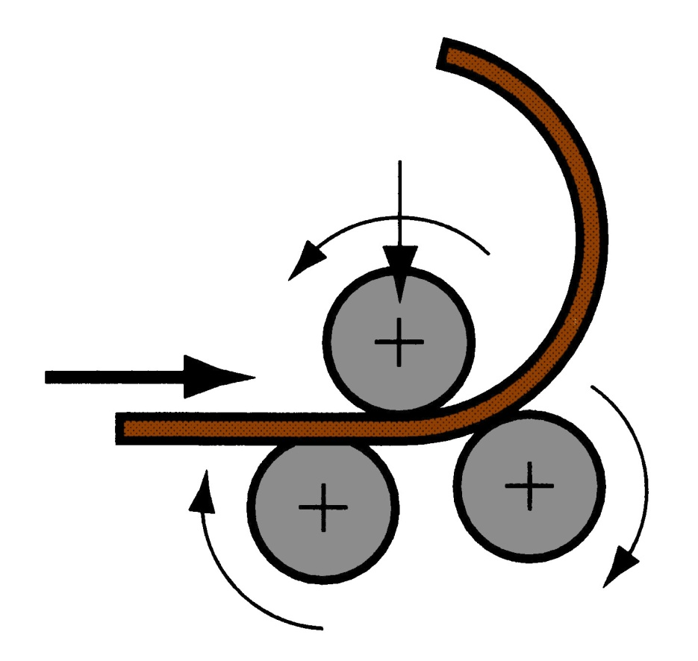
Roll Bending
Large metal sheets and plates are formed into curved sections using rolls
Figure 20.40 ‑ Roll bending

Slide 62
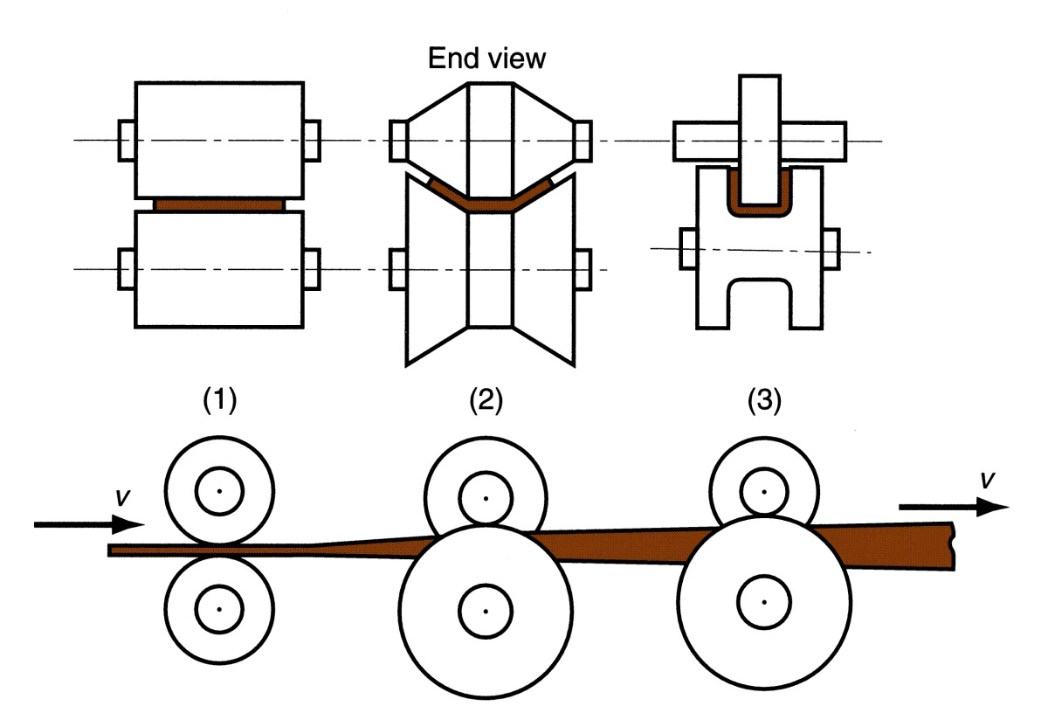
Roll Forming
Continuous bending process in which opposing rolls produce long sections of formed shapes from coil or strip stock
Figure 20.41 ‑ Roll forming of a continuous channel section:
straight rolls
partial form
final form

Slide 63
Spinning
Metal forming process in which an axially symmetric part is gradually shaped over a rotating mandrel using a rounded tool or roller
Three types:
  Conventional spinning
  Shear spinning
  Tube spinning

Slide 64
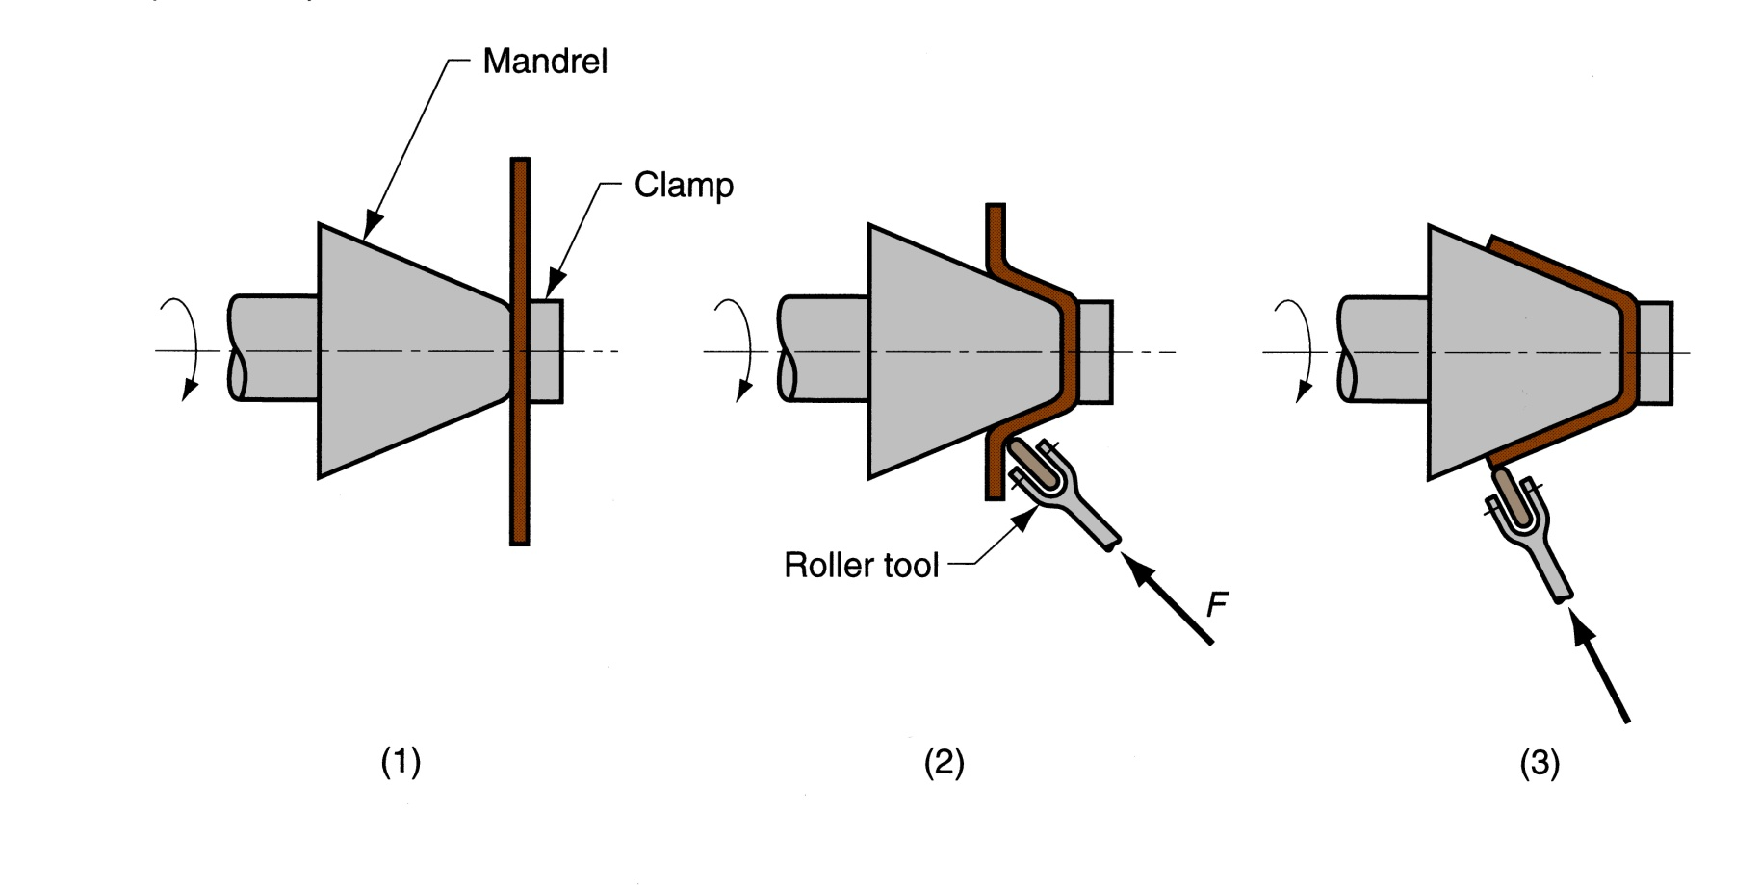
Figure 20.42 ‑ Conventional spinning: (1) setup at start of process; (2) during spinning; and (3) completion of process

Slide 65
High‑Energy‑Rate Forming (HERF)
Processes to form metals using large amounts of energy over a very short time
HERF processes include:
  Explosive forming
  Electrohydraulic forming
  Electromagnetic forming

Slide 66
Explosive Forming
Use of explosive charge to form sheet (or plate) metal into a die cavity
Explosive charge causes a shock wave whose energy is transmitted to force part into cavity
Applications: large parts, typical of aerospace industry

Slide 67
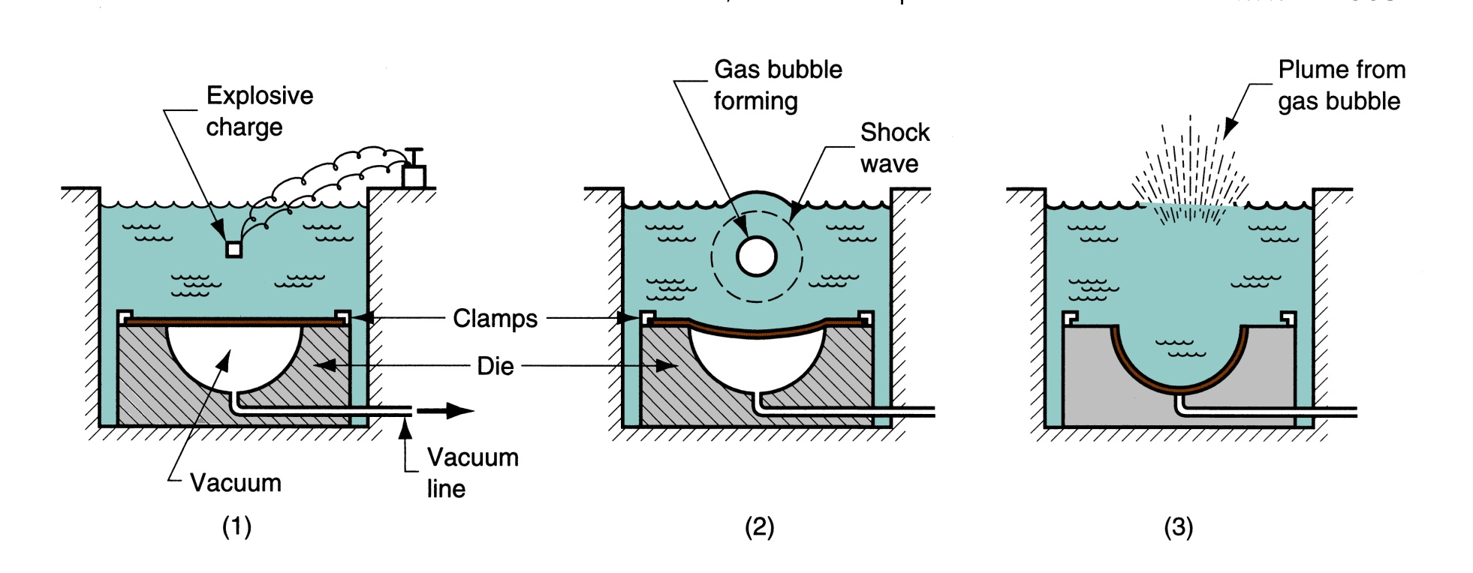
Figure 20.45 ‑ Explosive forming:
(1) setup, (2) explosive is detonated, and
(3) shock wave forms part and plume escapes water surface

Slide 68
Electromagnetic Forming
Sheet metal is deformed by mechanical force of an electromagnetic field induced in workpart by an energized coil
Presently the most widely used HERF process
Applications: tubular parts

Slide 69
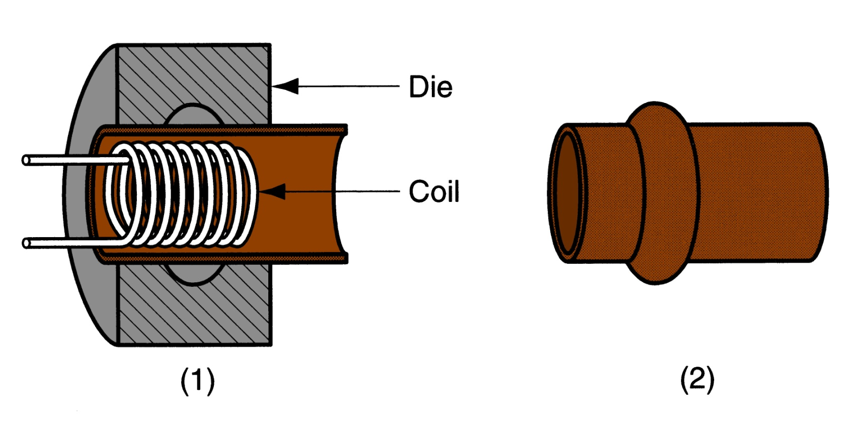
Figure 20.47 ‑ Electromagnetic forming: (1) setup in which coil is inserted into tubular workpart surrounded by die; (2) formed part

