Slide 1
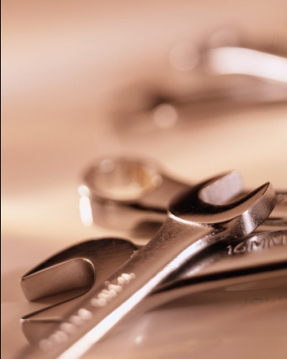
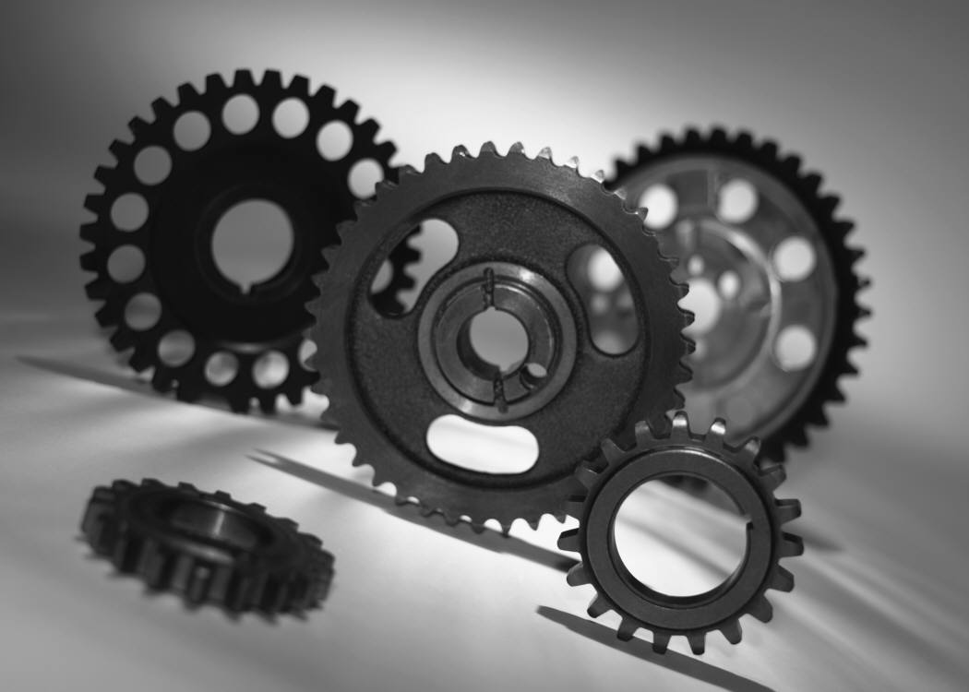
Chapter 19
BULK DEFORMATION PROCESSES
IN METALWORKING
Rolling
Other Deformation Processes Related to Rolling
Forging
Other Deformation Processes Related to Forging
Extrusion
Wire and Bar Drawing

Slide 2
Bulk Deformation
Metal forming operations which cause significant shape change by deformation in metal parts whose initial form is bulk rather than sheet
Starting forms: cylindrical bars and billets, rectangular billets and slabs, and similar shapes
These processes work by stressing metal sufficiently to cause plastic flow into desired shape
Performed as cold, warm, and hot working operations

Slide 3
Why do we use bulk processes?
Produces common shapes inexpensively
Good mechanical properties

Slide 4
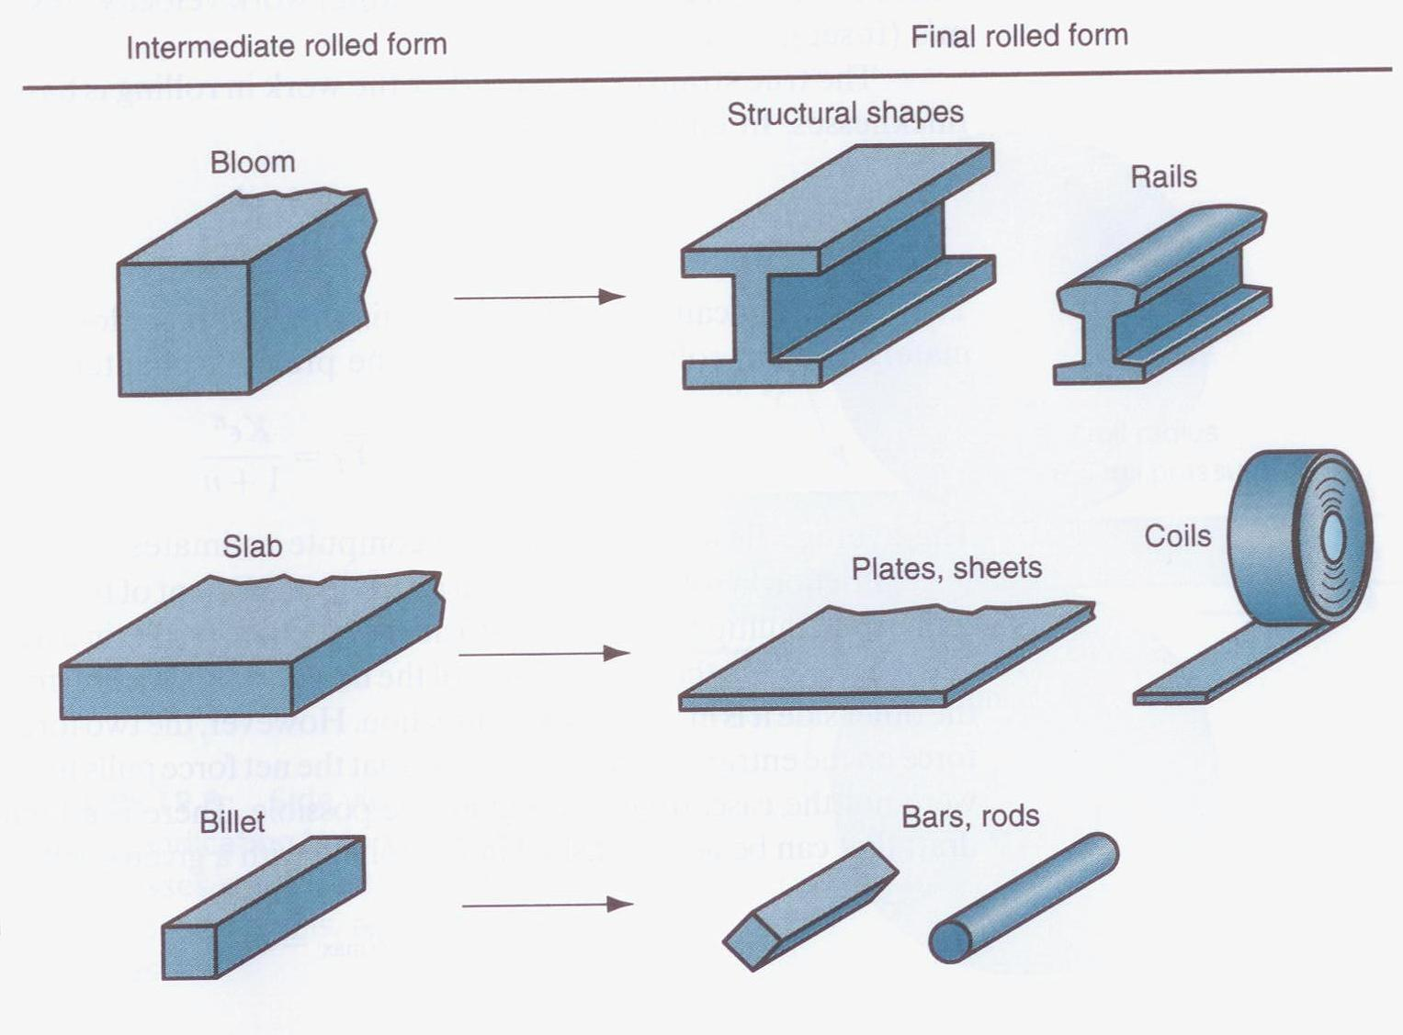
Common shapes

Slide 5
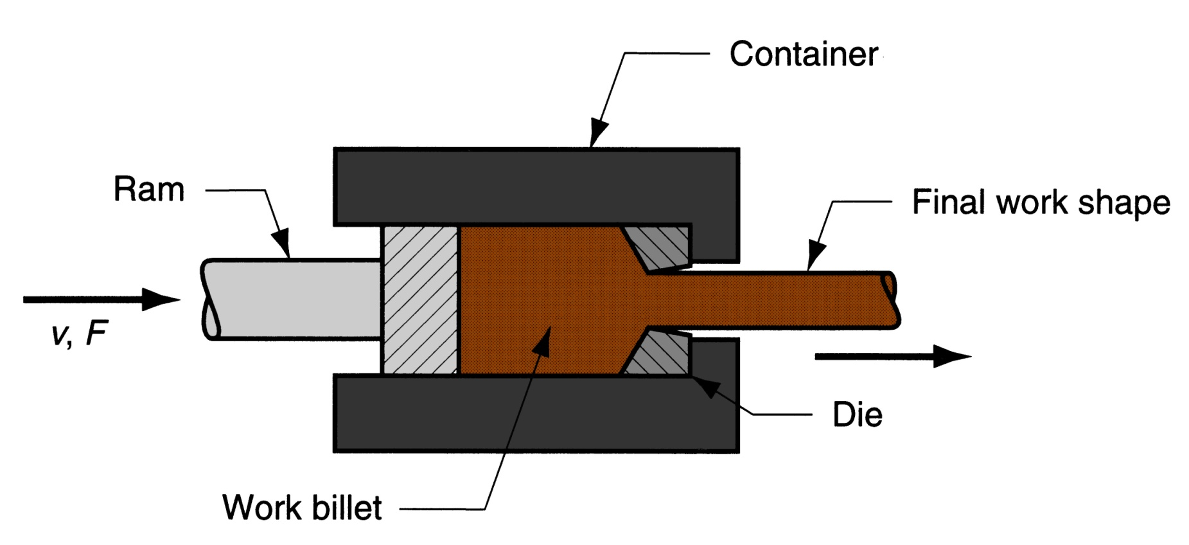
Basic principle
Push or pull
Single shot or continuous
Hot or cold
Malleable material
Refine and redirect the grain
Alters geometry
Alters material property
Reduction in size
v, F

Slide 6
Importance of Bulk Deformation
In hot working, significant shape change can be accomplished
In cold working, strength can be increased during shape change
Little or no waste - some operations are near net shape or net shape processes
  The parts require little or no subsequent machining

Slide 7
Four Basic Bulk Deformation Processes
Rolling – slab or plate is squeezed between opposing rolls
Forging – work is squeezed and shaped between between opposing dies
Extrusion – work is squeezed through a die opening, thereby taking the shape of the opening
Wire and bar drawing – diameter of wire or bar is reduced by pulling it through a die opening

Slide 8
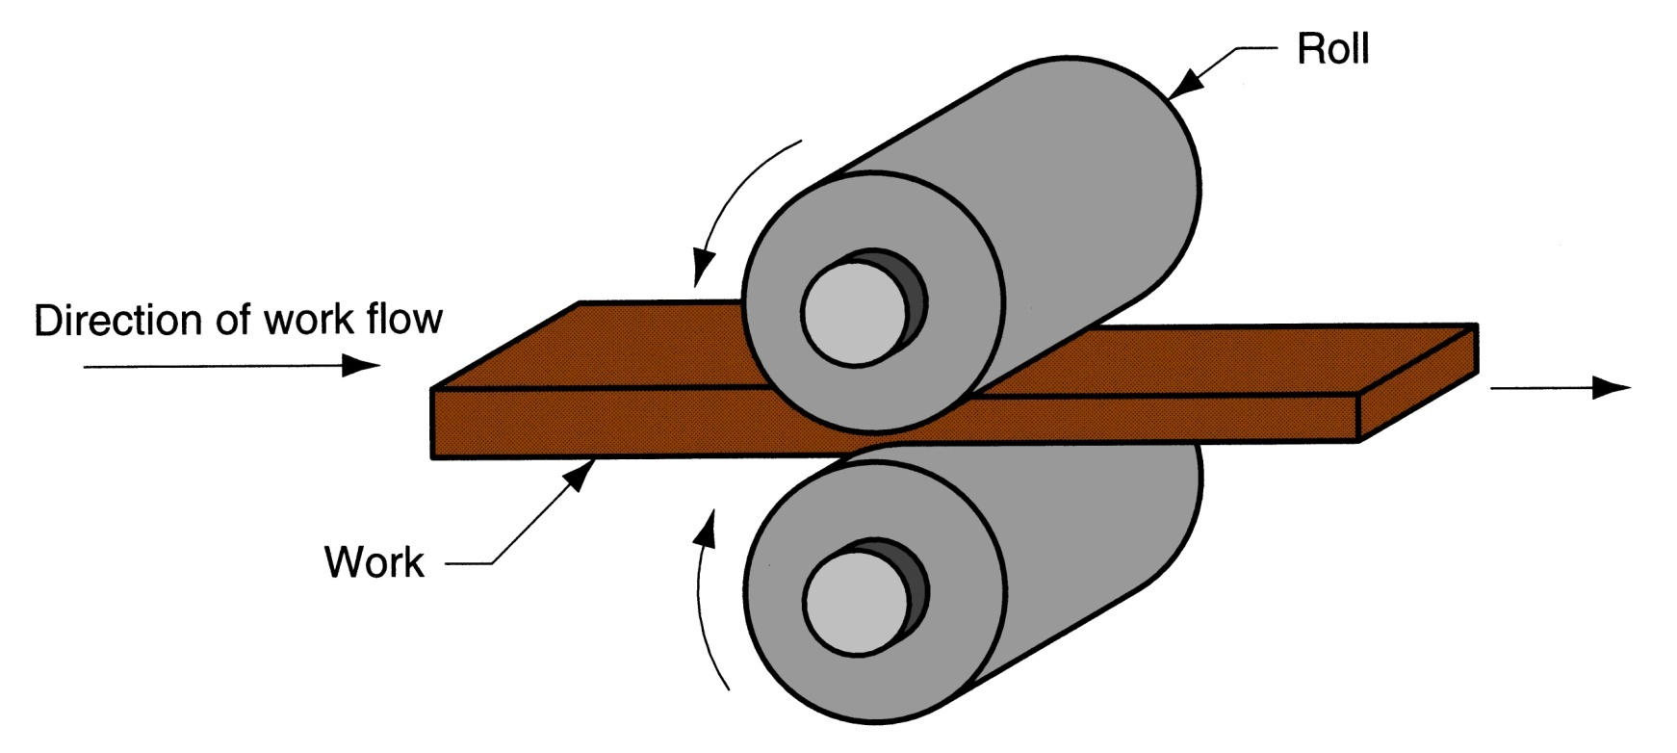
Rolling
Deformation process in which work thickness is reduced by compressive forces exerted by two opposing rolls
Figure 19.1 ‑ The rolling process (specifically, flat rolling)

Slide 9
The Rolls
The rotating rolls perform two main functions:
Pull the work into the gap between them by friction between workpart and rolls
Simultaneously squeeze the work to reduce cross section

Slide 10
Types of Rolling
By geometry of work:
  Flat rolling - used to reduce thickness of a rectangular cross‑section
  Shape rolling - a square cross‑section is formed into a shape such as an I‑beam
By temperature of work:
  Hot Rolling – most common due to the large amount of deformation required
  Cold rolling – produces finished sheet and plate stock

Slide 11
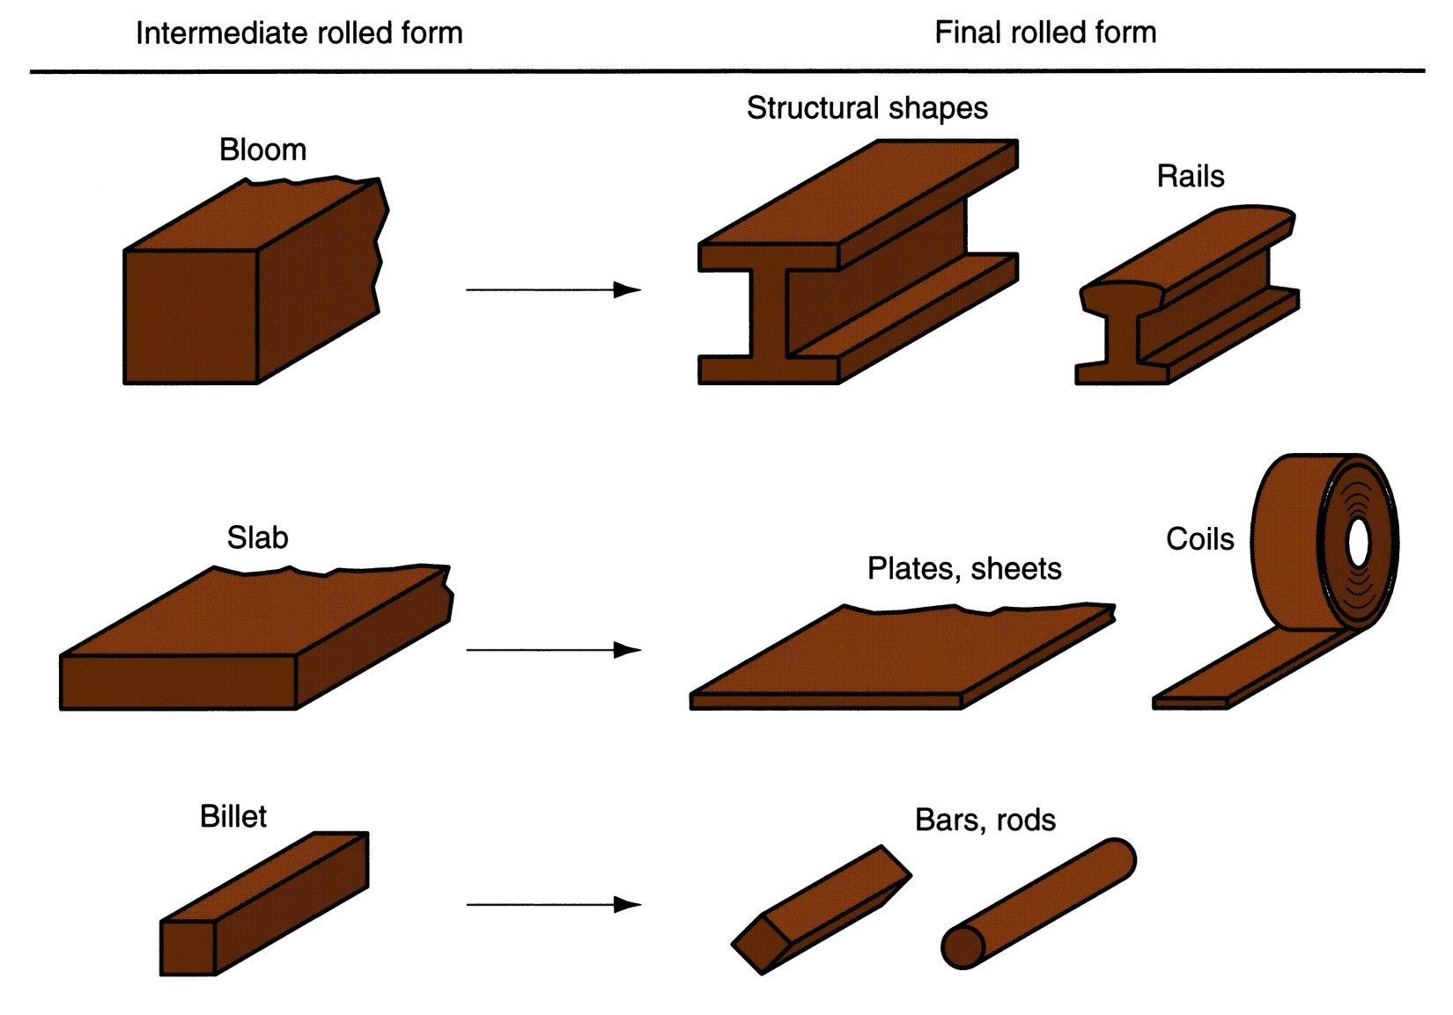
Figure 19.2 ‑ Some of the steel products made in a rolling mill

Slide 12
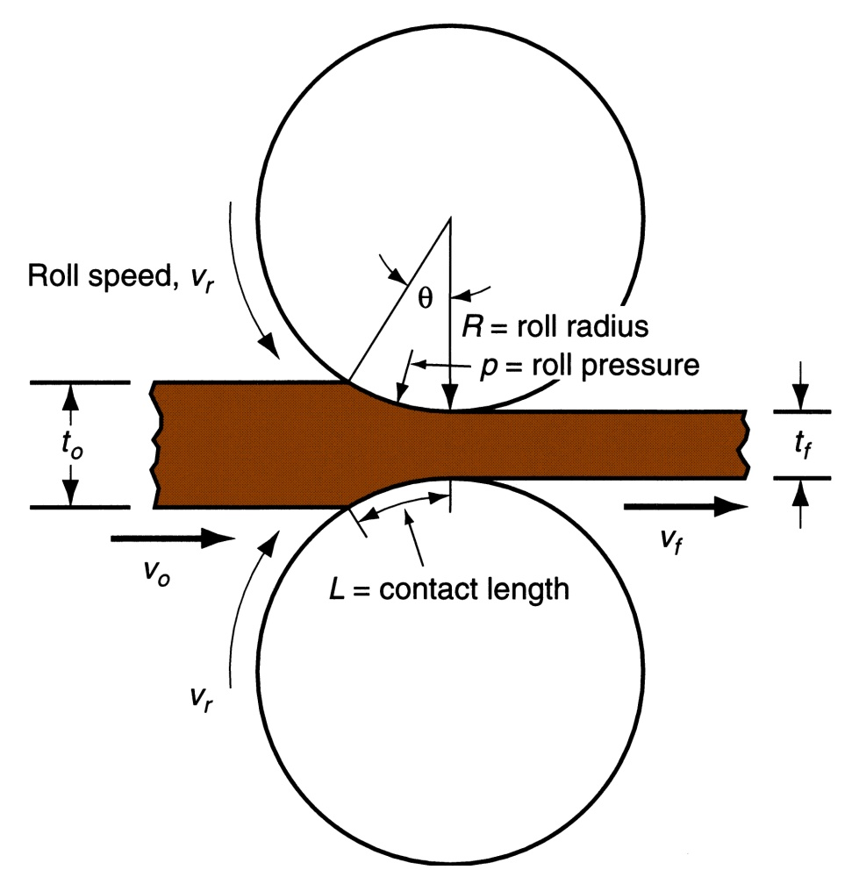
Figure 19.3 ‑ Side view of flat rolling, indicating before and after thicknesses, work velocities, angle of contact with rolls, and other features

Slide 13
Flat Rolling – Terminology
Draft = amount of thickness reduction
where d = draft; t_{o} = starting thickness; and t_{f} = final thickness

Slide 14
Flat Rolling – Terminology
Reduction = draft expressed as a fraction of starting stock thickness:
where r = reduction

Slide 15
Shape Rolling
Work is deformed into a contoured cross‑section rather than flat (rectangular)
Accomplished by passing work through rolls that have the reverse of desired shape
Products include:
  Construction shapes such as I‑beams, L‑beams, and U‑channels
  Rails for railroad tracks
  Round and square bars and rods

Slide 16
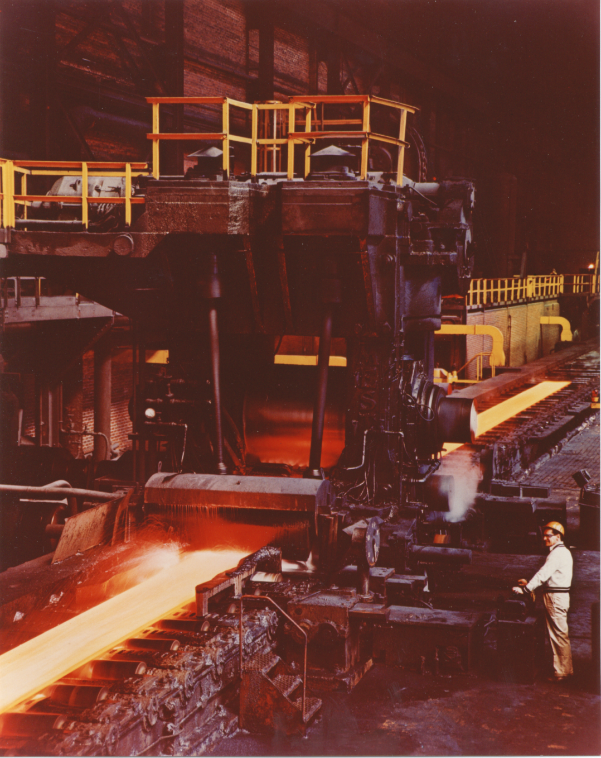
Figure 19.5 ‑ A rolling mill for hot flat rolling; the steel plate is seen as the glowing strip extending diagonally from the lower left corner
(photo courtesy of Bethlehem Steel Company)

Slide 17
Rolling Mills
Equipment is massive and expensive
Rolling mill configurations:
  Two-high – two opposing large diameter rolls
  Three-high – work passes through both directions
  Four-high – backing rolls support smaller work rolls
  Cluster mill – multiple backing rolls on smaller rolls
  Tandem rolling mill – sequence of two-high mills

Slide 18
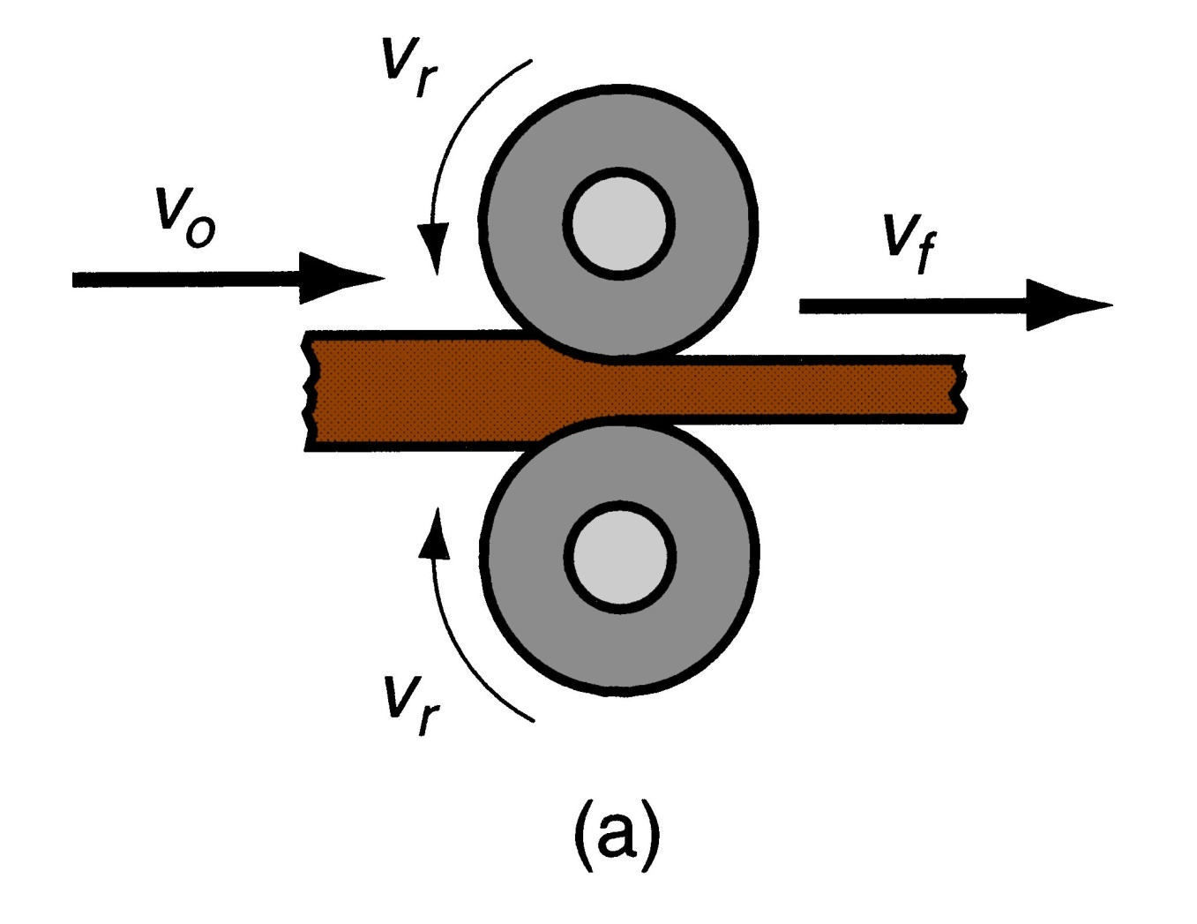
Figure 19.6 ‑ Various configurations of rolling mills:
(a) 2‑high rolling mill

Slide 19
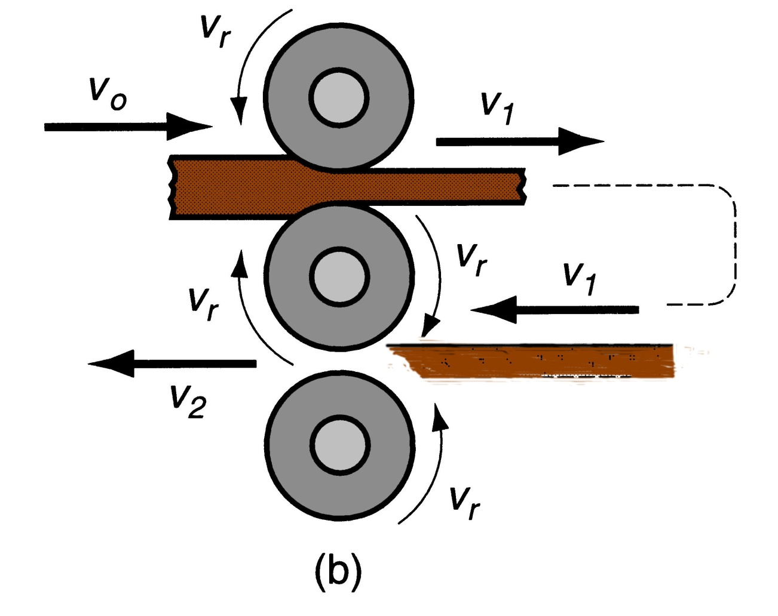
Figure 19.6 ‑ Various configurations of rolling mills:
(b) 3‑high rolling mill

Slide 20
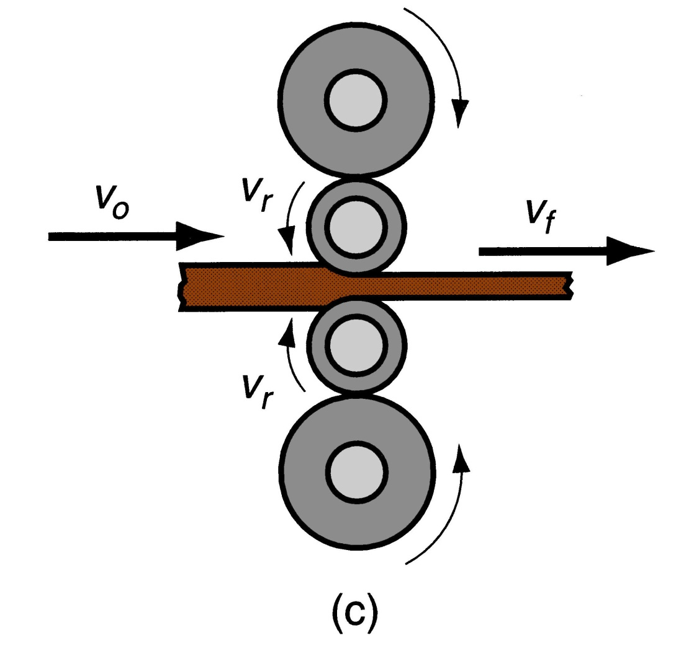
Figure 19.6 ‑ Various configurations of rolling mills:
(c) four‑high rolling mill

Slide 21
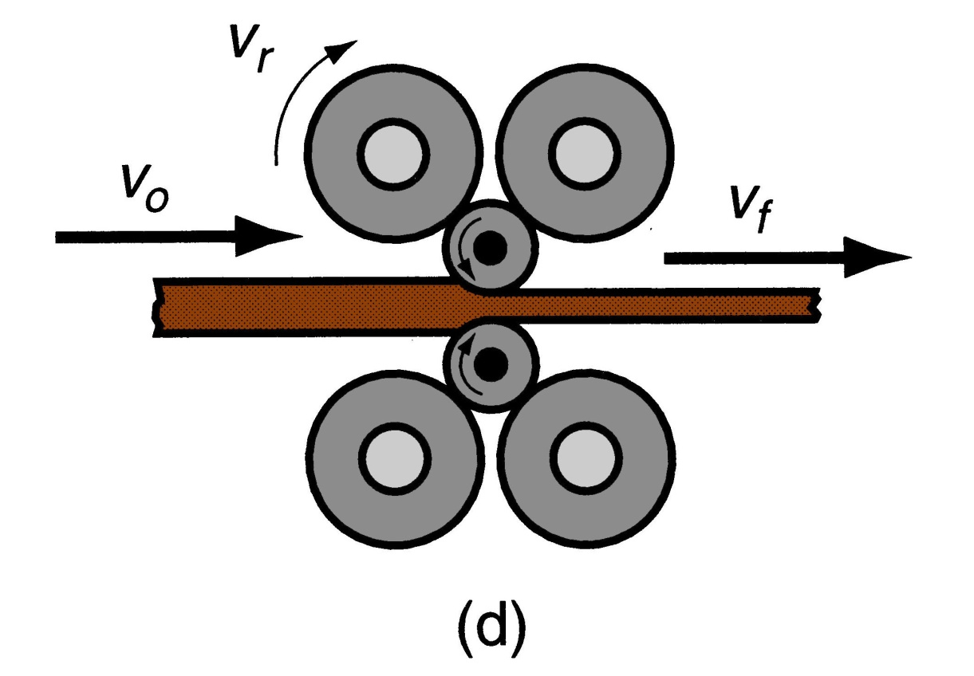
Cluster Mill
Multiple backing rolls allow even smaller roll diameters
Figure 19 6 ‑ Various configurations of rolling mills: (d) cluster mill

Slide 22
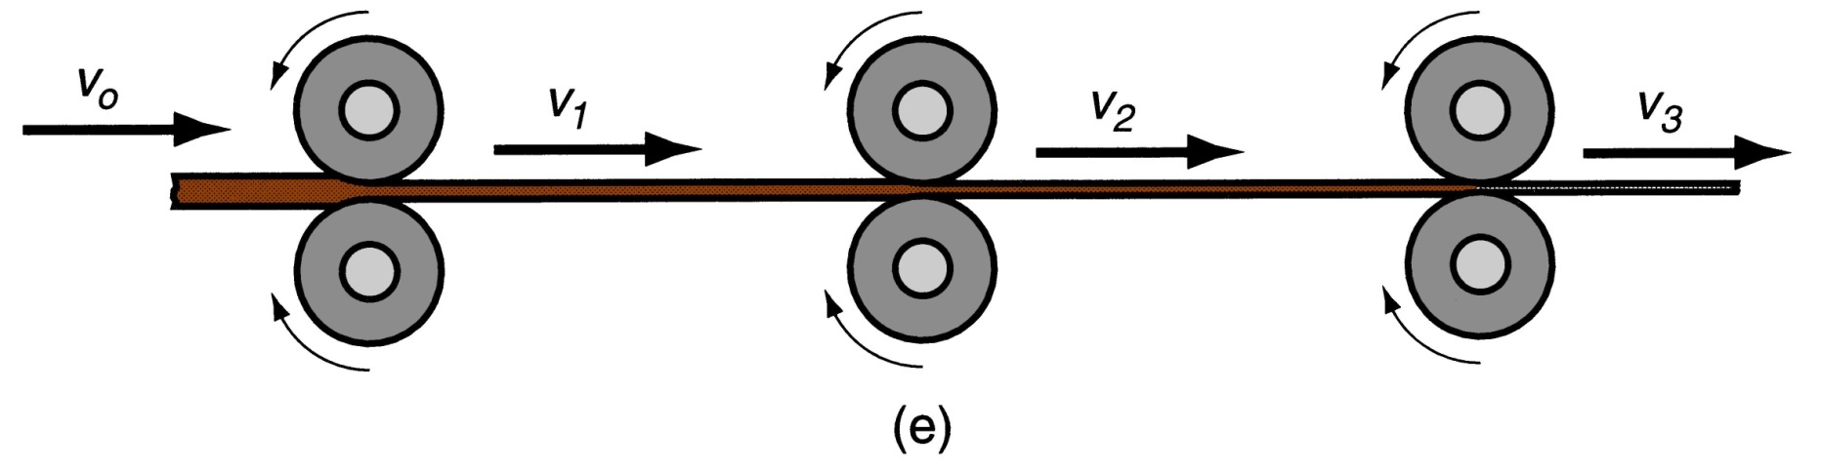
Tandem Rolling Mill
A series of rolling stands in sequence
Figure 19.6 ‑ Various configurations of rolling mills:
(e) tandem rolling mill

Slide 23
Thread Rolling
Bulk deformation process used to form threads on cylindrical parts by rolling them between two dies
Most important commercial process for mass producing bolts and screws
Performed by cold working in thread rolling machines
Advantages over thread cutting (machining):
  Higher production rates
  Better material utilization
  Stronger threads due to work hardening
  Better fatigue resistance due to compressive stresses introduced by rolling

Slide 24
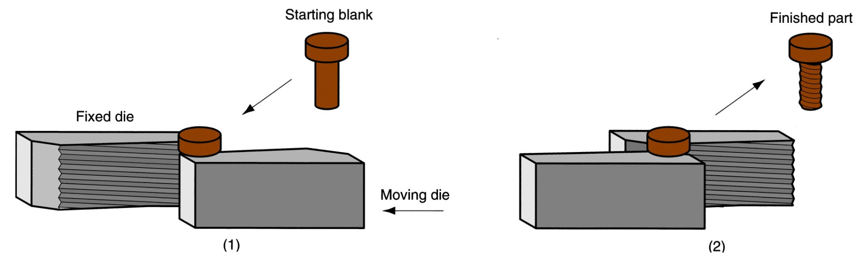
Figure 19.7 ‑ Thread rolling with flat dies:
(1) start of cycle, and (2) end of cycle

Slide 25
Ring Rolling
Deformation process in which a thick‑walled ring of smaller diameter is rolled into a thin‑walled ring of larger diameter
As thick‑walled ring is compressed, deformed metal elongates, causing diameter of ring to be enlarged
Hot working process for large rings and cold working process for smaller rings
Applications: ball and roller bearing races, steel tires for railroad wheels, and rings for pipes, pressure vessels, and rotating machinery
Advantages: material savings, ideal grain orientation, strengthening through cold working

Slide 26
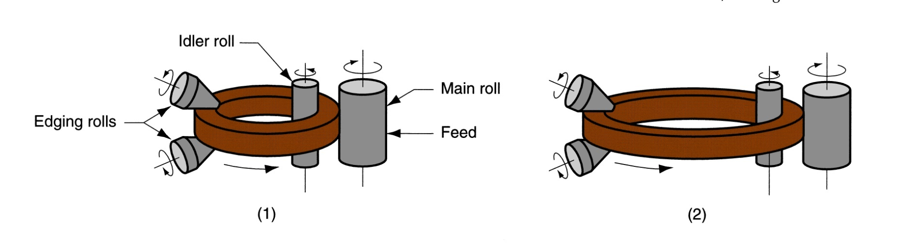
Figure 19.8 ‑ Ring rolling used to reduce the wall thickness and increase the diameter of a ring:
(1) start, and (2) completion of process

Slide 27
Forging
Deformation process in which work is compressed between two dies
Oldest of the metal forming operations, dating from about 5000 B C
Components: engine crankshafts, connecting rods, gears, aircraft structural components, jet engine turbine parts
In addition, basic metals industries use forging to establish basic form of large components that are subsequently machined to final shape and size

Slide 28
Classification of Forging Operations
Cold vs. hot forging:
  Hot or warm forging – most common, due to the significant deformation and the need to reduce strength and increase ductility of work metal
  Cold forging - advantage is increased strength that results from strain hardening
Impact vs. press forging:
  Forge hammer - applies an impact load
  Forge press - applies gradual pressure

Slide 29
Types of Forging Dies
Open‑die forging - work is compressed between two flat dies, allowing metal to flow laterally without constraint
Impression‑die forging - die surfaces contain a cavity or impression that is imparted to workpart, thus constraining metal flow - flash is created
Flashless forging - workpart is completely constrained in die and no excess flash is produced

Slide 30
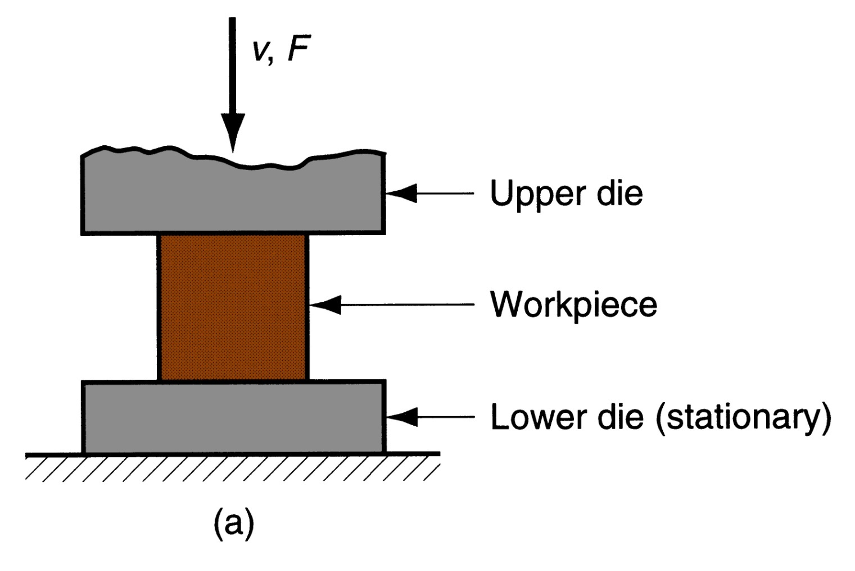
Figure 19.10 ‑ Three types of forging: (a) open‑die forging

Slide 31
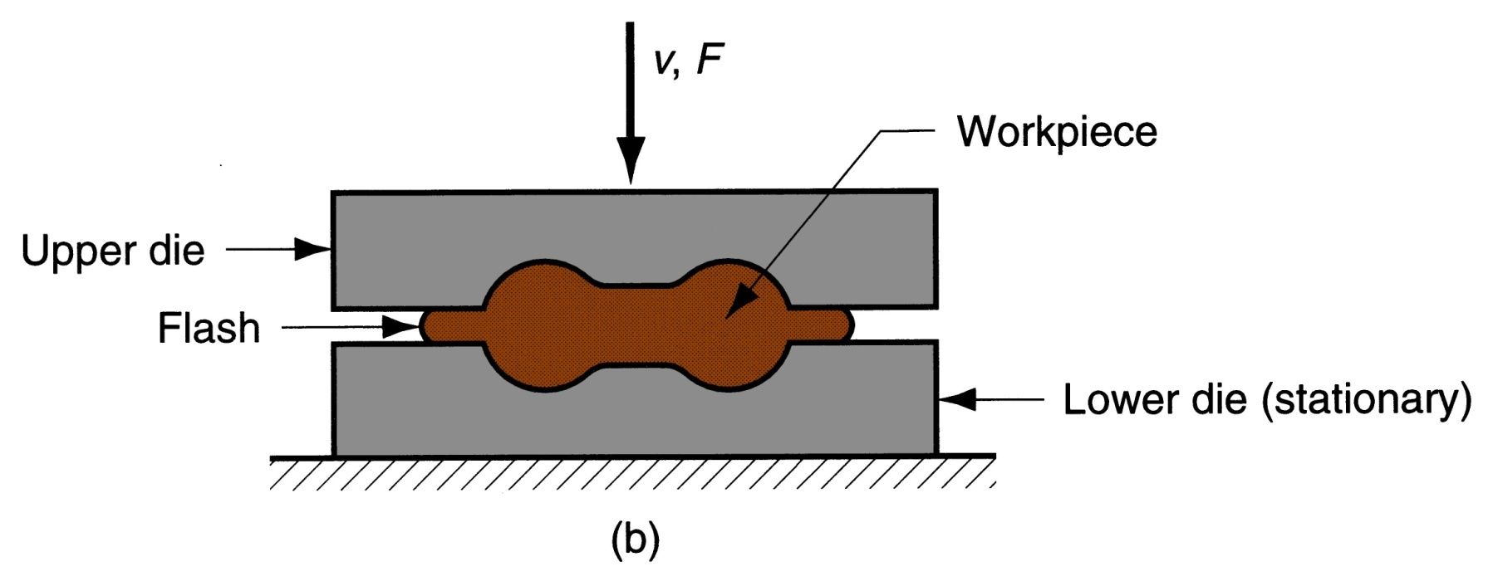
Figure 19.10 ‑ Three types of forging (b) impression‑die forging

Slide 32
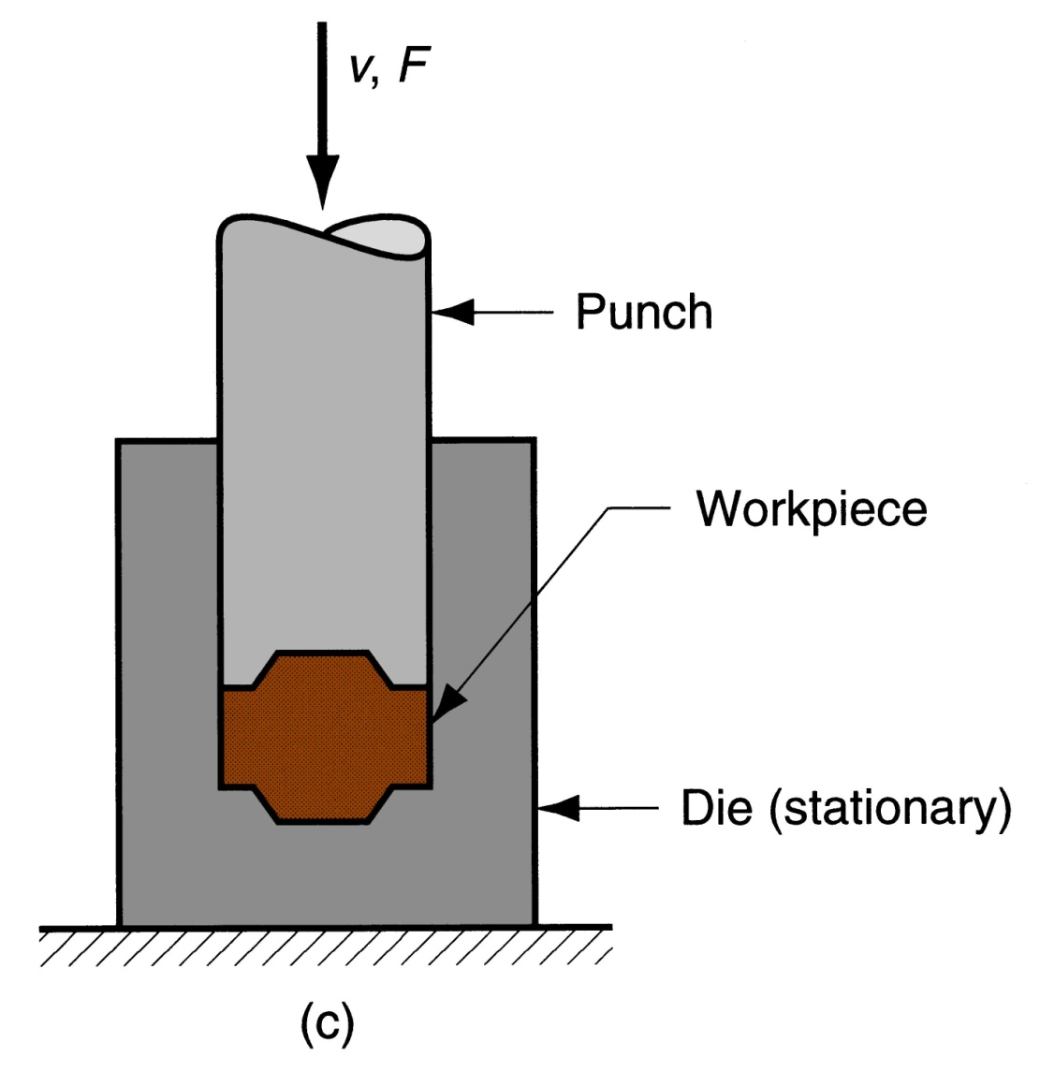
Figure 19.10 ‑ Three types of forging (c) flashless forging

Slide 33
Open‑Die Forging
Compression of workpart with cylindrical cross‑section between two flat dies
Similar to compression test
Deformation operation reduces height and increases diameter of work
Common names include upsetting or upset forging

Slide 34
Open‑Die Forging with No Friction
If no friction occurs between work and die surfaces, then homogeneous deformation occurs, so that radial flow is uniform throughout workpart height and true strain is given by:
  where h_{o}= starting height; and h = height at some point during compression
At h = final value h_{f}, true strain is maximum value

Slide 35
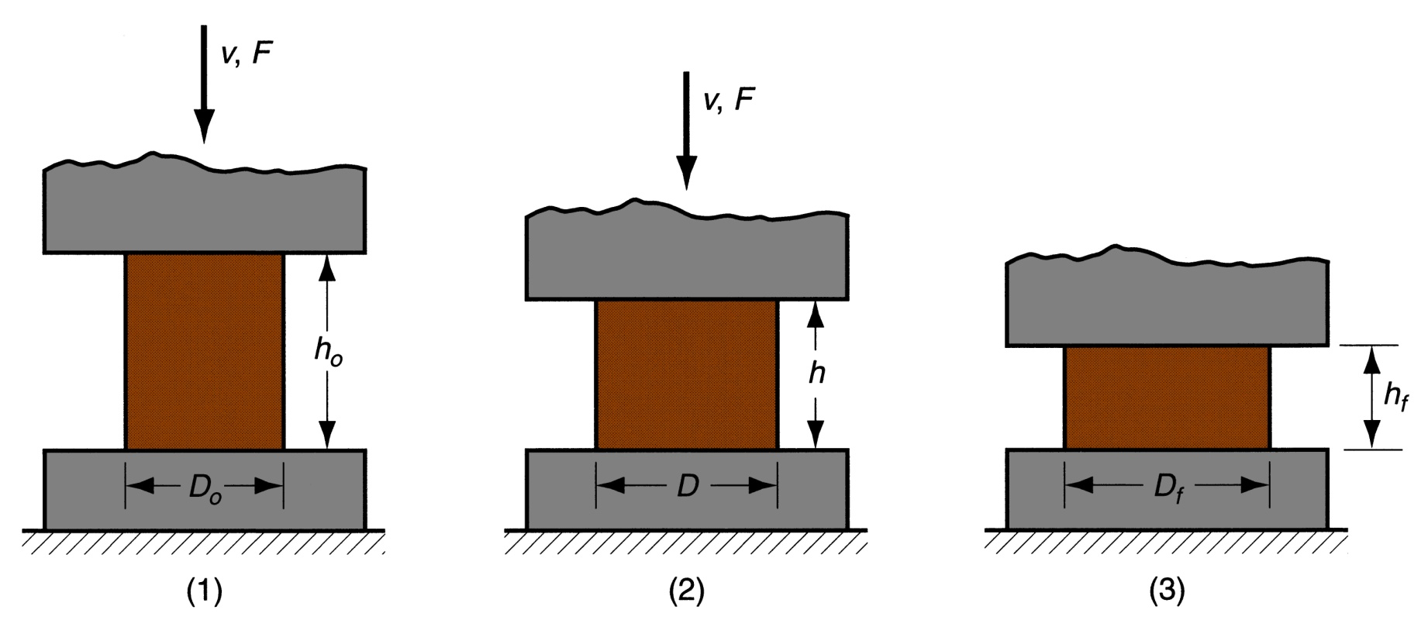
Figure 19.11 ‑ Homogeneous deformation of a cylindrical workpart under ideal conditions in an open‑die forging operation:
(1) start of process with workpiece at its original length and diameter, (2) partial compression, and (3) final size

Slide 36
Open-Die Forging with Friction
Friction between work and die surfaces constrains lateral flow of work, resulting in barreling effect
In hot open-die forging, effect is even more pronounced due to heat transfer at and near die surfaces, which cools the metal and increases its resistance to deformation

Slide 37
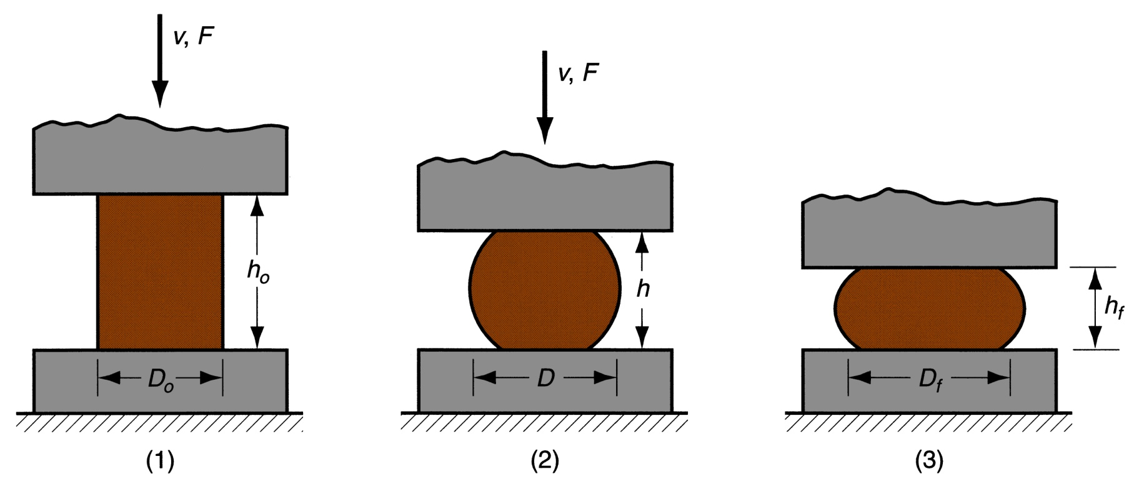
Figure 19.12 ‑ Actual deformation of a cylindrical workpart in open‑die forging, showing pronounced barreling:
(1) start of process, (2) partial deformation, and (3) final shape

Slide 38
Impression‑Die Forging
Compression of workpart by dies with inverse of desired part shape
Flash is formed by metal that flows beyond die cavity into small gap between die plates
Flash must be later trimmed from part, but it serves an important function during compression:
  As flash forms, friction resists continued metal flow into gap, constraining material to fill die cavity
  In hot forging, metal flow is further restricted by cooling against die plates

Slide 39
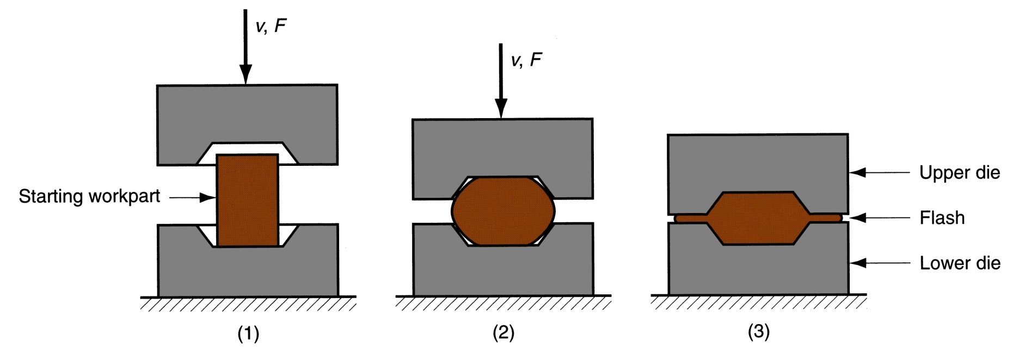
Figure 19.15 ‑ Sequence in impression‑die forging:
just prior to initial contact with raw workpiece,
partial compression, and
final die closure, causing flash to form in gap between die plates

Slide 40
Impression‑Die Forging Practice
Several forming steps often required, with separate die cavities for each step
  Beginning steps redistribute metal for more uniform deformation and desired metallurgical structure in subsequent steps
  Final steps bring the part to its final geometry
  Impression-die forging is often performed manually by skilled operator under adverse conditions

Slide 41
Impression‑Die Forging
Advantages and Limitations
Advantages compared to machining from solid stock:
  Higher production rates
  Conservation of metal (less waste)
  Greater strength
  Favorable grain orientation in the metal
Limitations:
  Not capable of close tolerances
  Machining often required to achieve accuracies and features needed, such as holes, threads, and mating surfaces that fit with other components

Slide 42
Flashless Forging
Compression of work in punch and die tooling whose cavity does allow for flash
Starting workpart volume must equal die cavity volume within very close tolerance
Process control more demanding than impression‑die forging
Best suited to part geometries that are simple and symmetrical
Often classified as a precision forging process

Slide 43
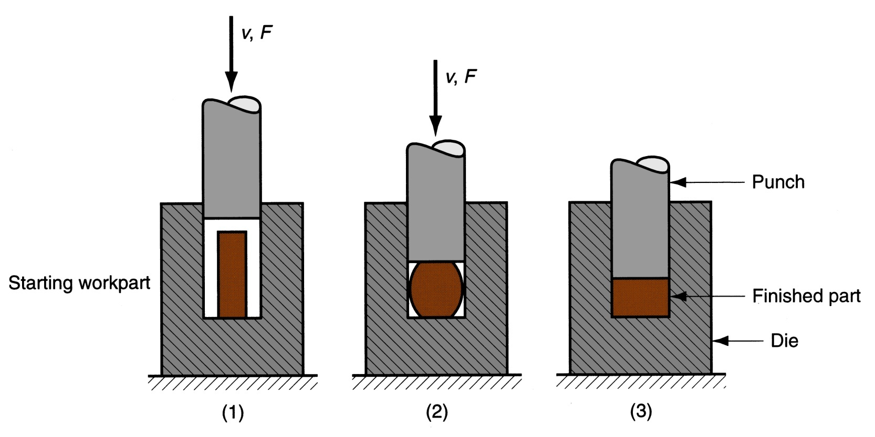
Figure 19.18 ‑ Flashless forging:
just before initial contact with workpiece,
partial compression, and
final punch and die closure

Slide 44
Forging Hammers (Drop Hammers)
Apply an impact load against workpart - two types:
  Gravity drop hammers - impact energy from falling weight of a heavy ram
  Power drop hammers - accelerate the ram by pressurized air or steam
Disadvantage: impact energy transmitted through anvil into floor of building
Most commonly used for impression-die forging

Slide 45
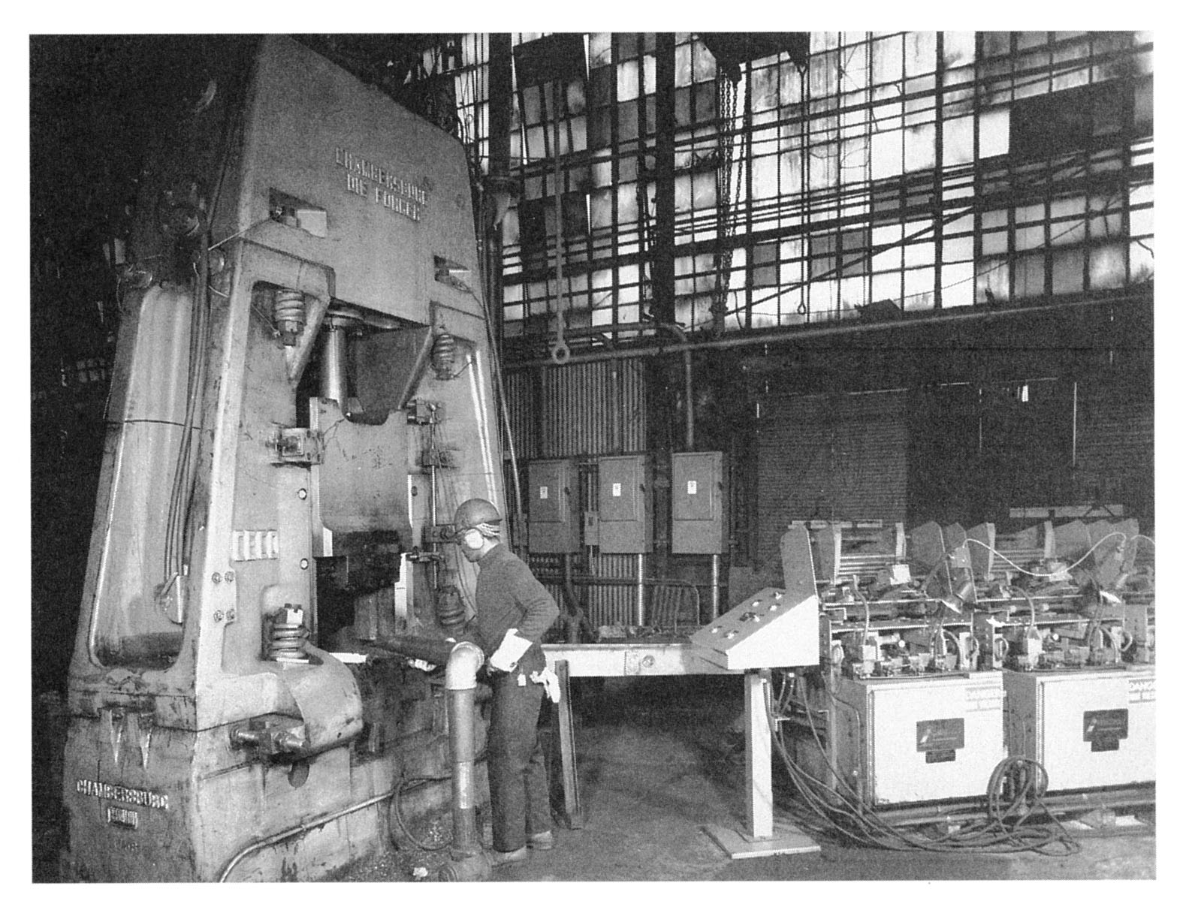
Figure 19.20 ‑ Drop forging hammer, fed by conveyor and heating units at the right of the scene
(photo courtesy of Chambersburg Engineering Company)

Slide 46
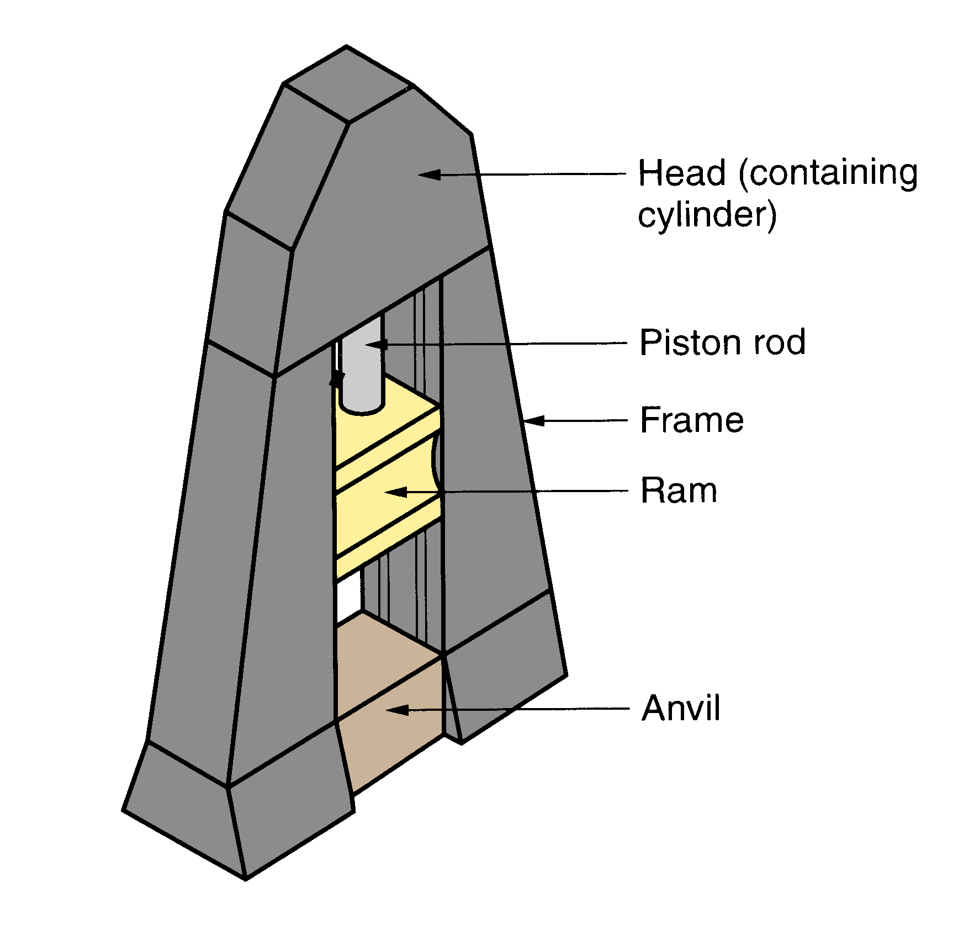
Figure 19.21 ‑ Diagram showing details of a drop hammer for impression‑die forging

Slide 47
Forging Presses
Apply gradual pressure to accomplish compression operation - types:
  Mechanical presses - converts rotation of drive motor into linear motion of ram
  Hydraulic presses - hydraulic piston actuates ram
  Screw presses - screw mechanism drives ram

Slide 48
Upsetting and Heading
Forging process used to form heads on nails, bolts, and similar hardware products
More parts produced by upsetting than any other forging operation
Performed cold, warm, or hot on machines called headers or formers
Wire or bar stock is fed into machine, end is headed, then piece is cut to length
For bolts and screws, thread rolling is then used to form threads

Slide 49
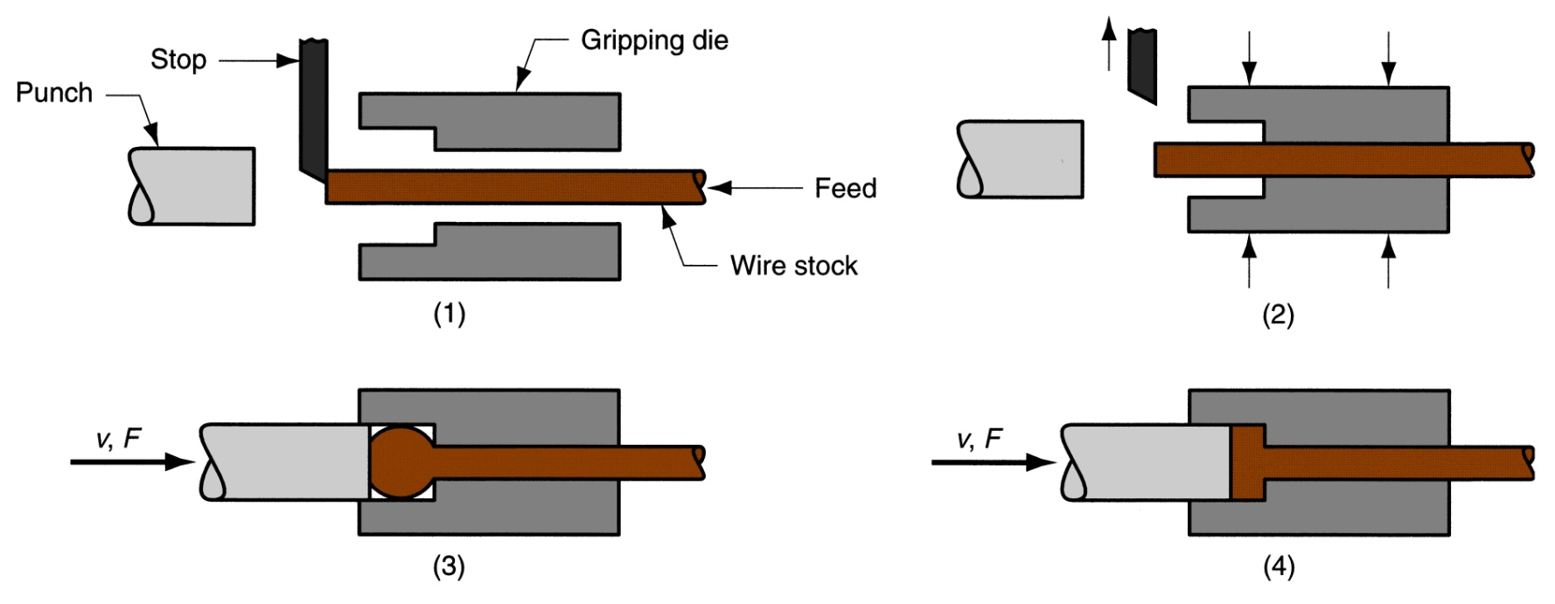
Figure 19.23 ‑ An upset forging operation to form a head on a bolt or similar hardware item The cycle consists of:
wire stock is fed to the stop
(2) gripping dies close on the stock and the stop is retracted
(3) punch moves forward
(4) bottoms to form the head

Slide 50
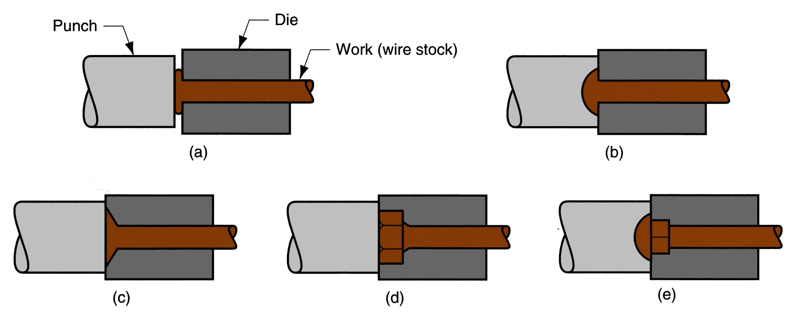
Figure 19.24 ‑ Examples of heading (upset forging) operations:
heading a nail using open dies
round head formed by punch
(c) and (d) two common head styles for screws formed by die
(e) carriage bolt head formed by punch and die

Slide 51
Swaging
Accomplished by rotating dies that hammer a workpiece radially inward to taper it as the piece is fed into the dies
Used to reduce diameter of tube or solid rod stock
Mandrel sometimes required to control shape and size of internal diameter of tubular parts

Slide 52
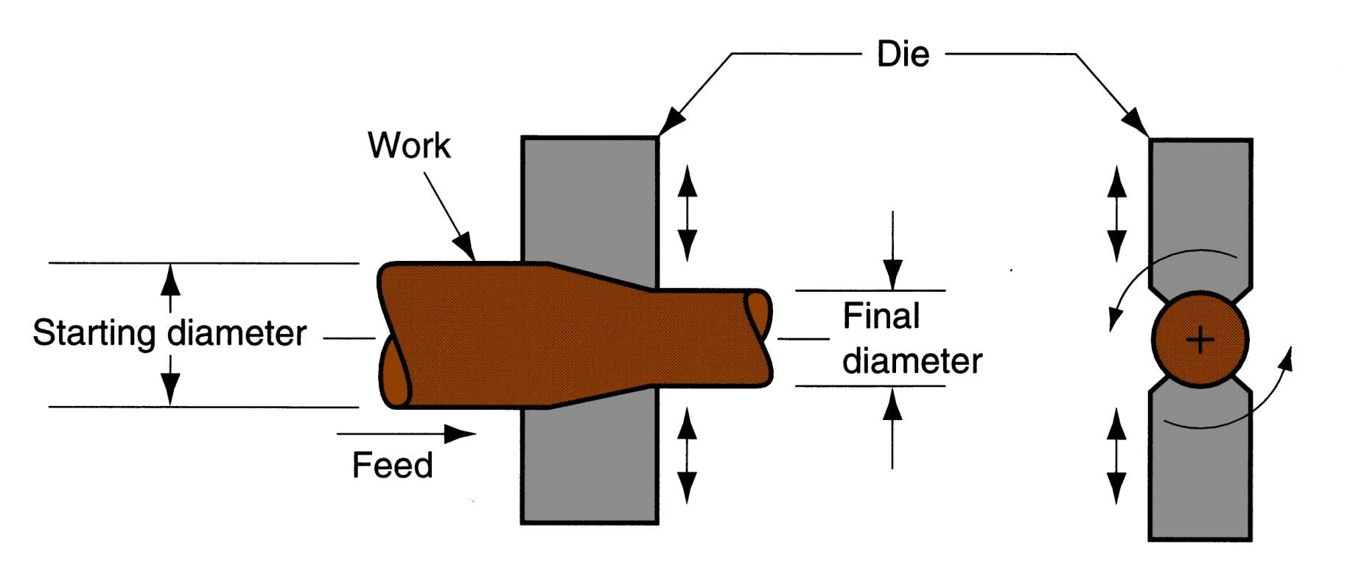
Figure 19.25 ‑ Swaging process to reduce solid rod stock; the dies rotate as they hammer the work In radial forging, the workpiece rotates while the dies remain in a fixed orientation as they hammer the work

Slide 53
Trimming
Cutting operation to remove flash from workpart in impression‑die forging
Usually done while work is still hot, so a separate trimming press is included at the forging station
Trimming can also be done by alternative methods, such as grinding or sawing

Slide 54
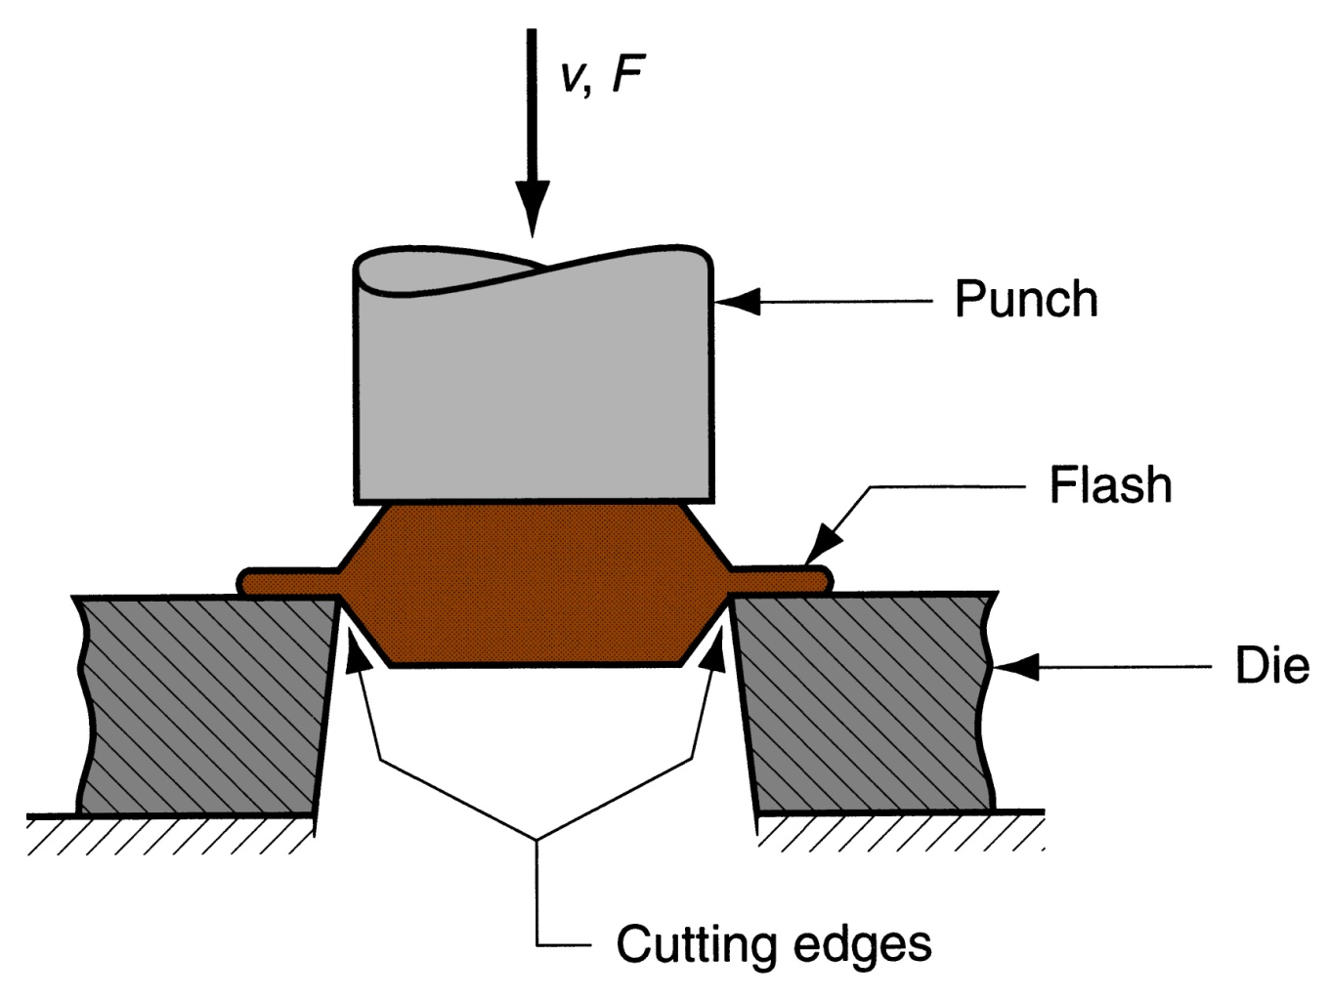
Figure 19.30 ‑ Trimming operation (shearing process) to remove the flash after impression‑die forging

Slide 55
Extrusion
Compression forming process in which the work metal is forced to flow through a die opening to produce a desired cross‑sectional shape
Process is similar to squeezing toothpaste out of a toothpaste tube
In general, extrusion is used to produce long parts of uniform cross-sections
Two basic types of extrusion:
  Direct extrusion
  Indirect extrusion

Slide 56
Figure 19.31 ‑ Direct extrusion

Slide 57
Comments on Direct Extrusion
Also called forward extrusion
As ram approaches die opening, a small portion of billet remains that cannot be forced through die opening
This extra portion, called the butt, must be separated from extruded product by cutting it just beyond the die exit
Starting billet cross section usually round, but final shape is determined by die opening

Slide 58
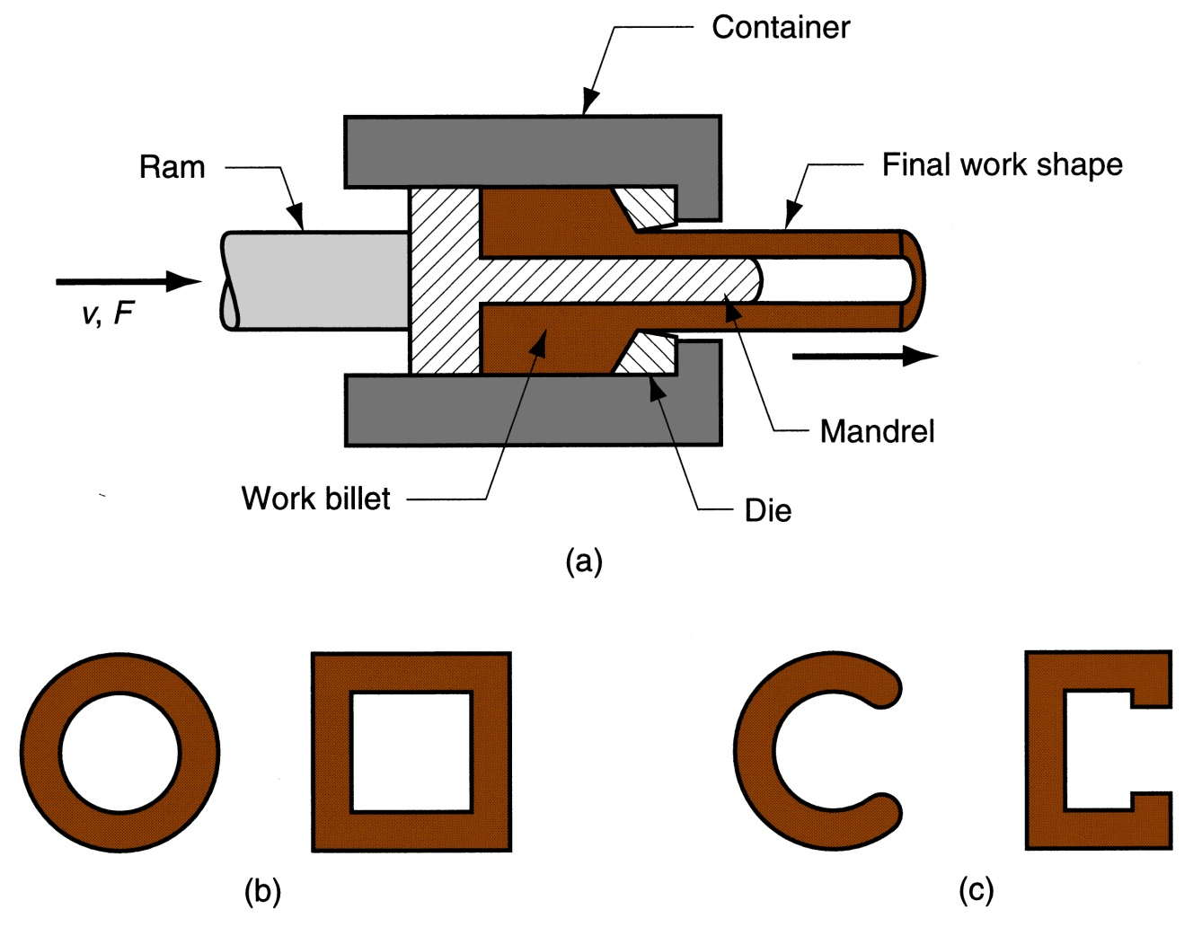
Figure 19.32 ‑ (a) Direct extrusion to produce a hollow or semi‑hollow cross‑section; (b) hollow and (c) semi‑hollow cross‑ sections

Slide 59
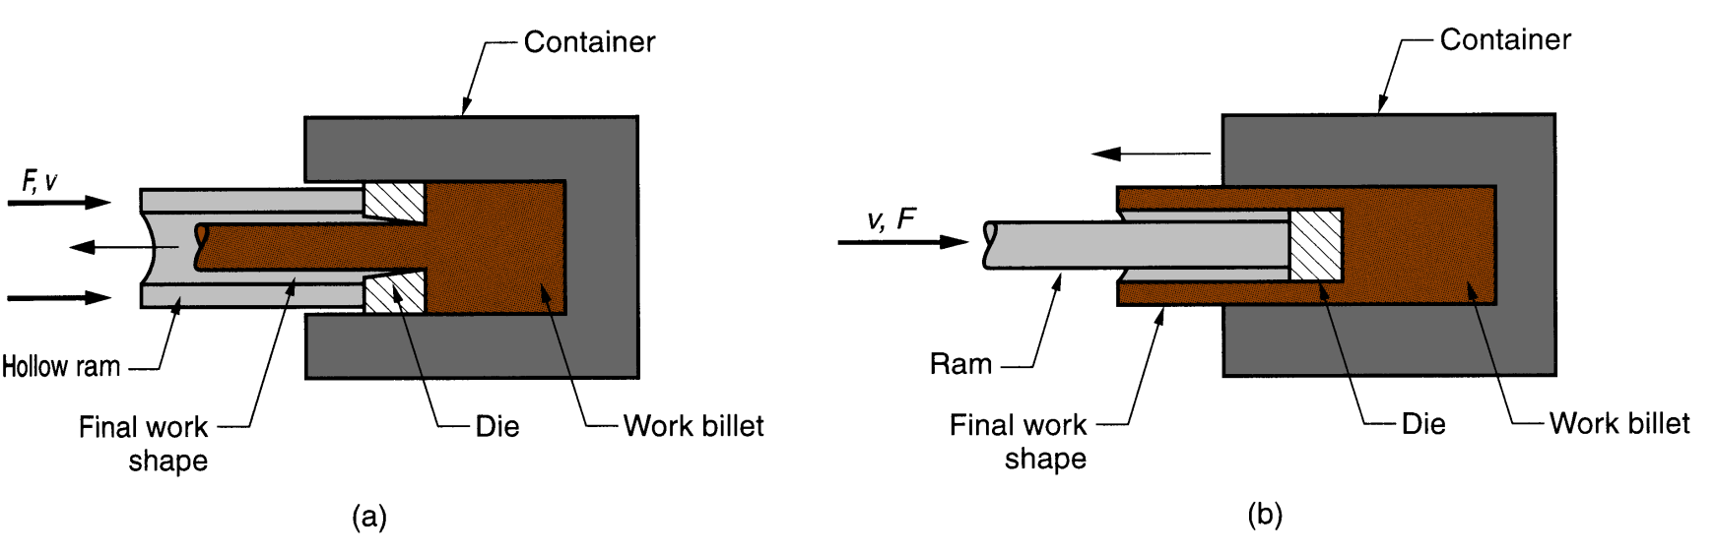
Figure 19.33 ‑ Indirect extrusion to produce
(a) a solid cross‑section and (b) a hollow cross‑section

Slide 60
Comments on Indirect Extrusion
Also called backward extrusion and reverse extrusion
Limitations of indirect extrusion are imposed by the lower rigidity of hollow ram and difficulty in supporting extruded product as it exits die

Slide 61
General Advantages of Extrusion
Variety of shapes possible, especially in hot extrusion
  Limitation: part cross‑section must be uniform throughout length
Grain structure and strength enhanced in cold and warm extrusion
Close tolerances possible, especially in cold extrusion
In some operations, little or no waste of material

Slide 62
Hot vs. Cold Extrusion
Hot extrusion - prior heating of billet to above its recrystallization temperature
  This reduces strength and increases ductility of the metal, permitting more size reductions and more complex shapes
Cold extrusion - generally used to produce discrete parts
  The term impact extrusion is used to indicate high speed cold extrusion

Slide 63
Extrusion Ratio
Also called the reduction ratio, it is defined as
where r_{x} = extrusion ratio; A_{o} = cross-sectional area of the starting billet; and A_{f} = final cross-sectional area of the extruded section
Applies to both direct and indirect extrusion

Slide 64
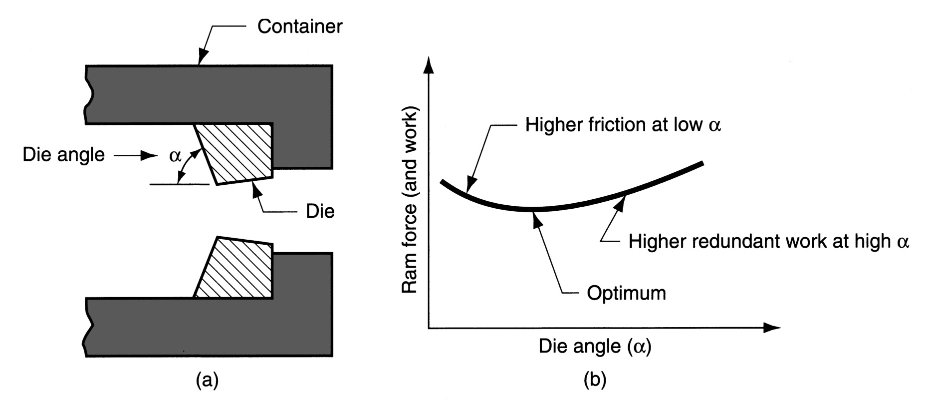
Figure 19.36 ‑
(a) Definition of die angle in direct extrusion;
(b) effect of die angle on ram force

Slide 65
Comments on Die Angle
Low die angle - surface area is large, leading to increased friction at die‑billet interface
  Higher friction results in larger ram force
Large die angle - more turbulence in metal flow during reduction
  Turbulence increases ram force required
Optimum angle depends on work material, billet temperature, and lubrication

Slide 66
Comments on Orifice Shape of Extrusion Die
Simplest cross section shape = circular die orifice
Shape of die orifice affects ram pressure
As cross‑section becomes more complex, higher pressure and greater force are required

Slide 67
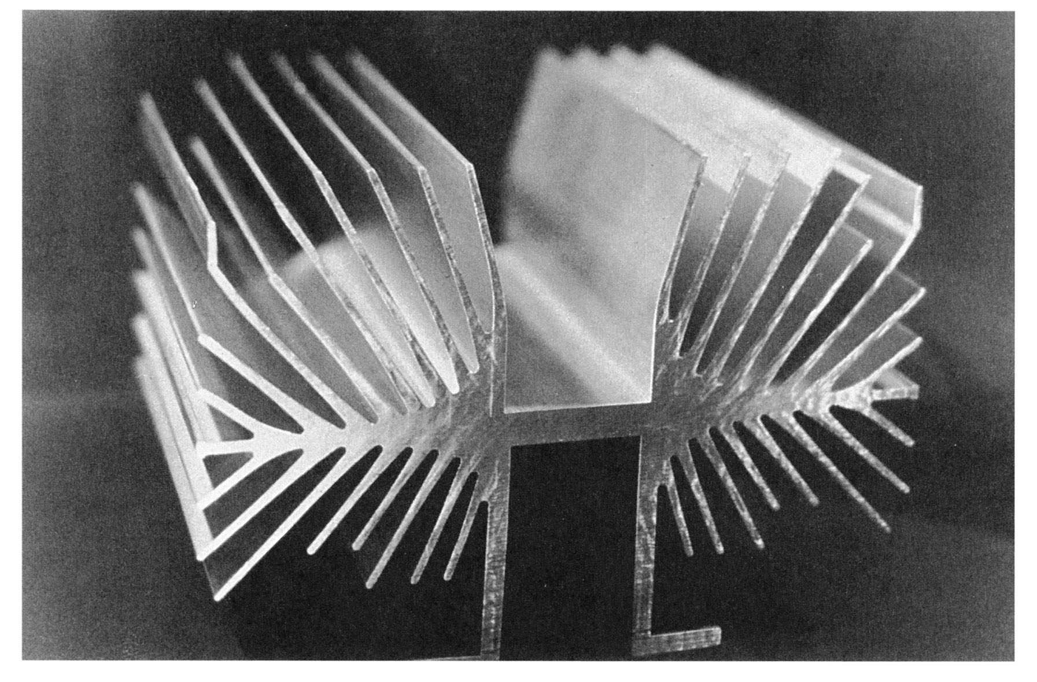
Figure 19.37 ‑ A complex extruded cross‑section for a heat sink (photo courtesy of Aluminum Company of America)

Slide 68
Extrusion Presses
Either horizontal or vertical
  Horizontal more common
Extrusion presses - usually hydraulically driven, which is especially suited to semi‑continuous direct extrusion of long sections
Mechanical drives - often used for cold extrusion of individual parts

Slide 69
Wire and Bar Drawing
Cross‑section of a bar, rod, or wire is reduced by pulling it through a die opening
Similar to extrusion except work is pulled through die in drawing (it is pushed through in extrusion)
Although drawing applies tensile stress, compression also plays a significant role since metal is squeezed as it passes through die opening

Slide 70
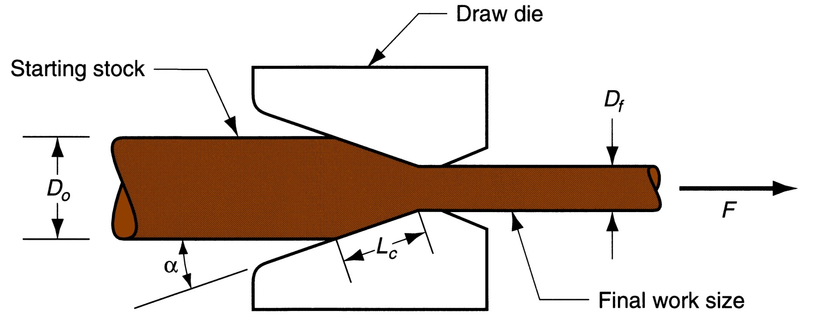
Figure 19.41 ‑ Drawing of bar, rod, or wire

Slide 71
Area Reduction in Drawing
Change in size of work is usually given by area reduction:
where r = area reduction in drawing; A_{o} = original area of work; and A_{r} = final work

Slide 72
Wire Drawing vs. Bar Drawing
Difference between bar drawing and wire drawing is stock size
  Bar drawing - large diameter bar and rod stock
  Wire drawing - small diameter stock - wire sizes down to 0.03 mm (0.001 in.) are possible
Although the mechanics are the same, the methods, equipment, and even terminology are different

Slide 73
Drawing Practice and Products
Drawing practice:
  Usually performed as cold working
  Most frequently used for round cross‑sections
Products:
  Wire: electrical wire; wire stock for fences, coat hangers, and shopping carts
  Rod stock for nails, screws, rivets, and springs
  Bar stock: metal bars for machining, forging, and other processes

Slide 74
Bar Drawing
Accomplished as a single‑draft operation ‑ the stock is pulled through one die opening
Beginning stock has large diameter and is a straight cylinder
This necessitates a batch type operation

Slide 75
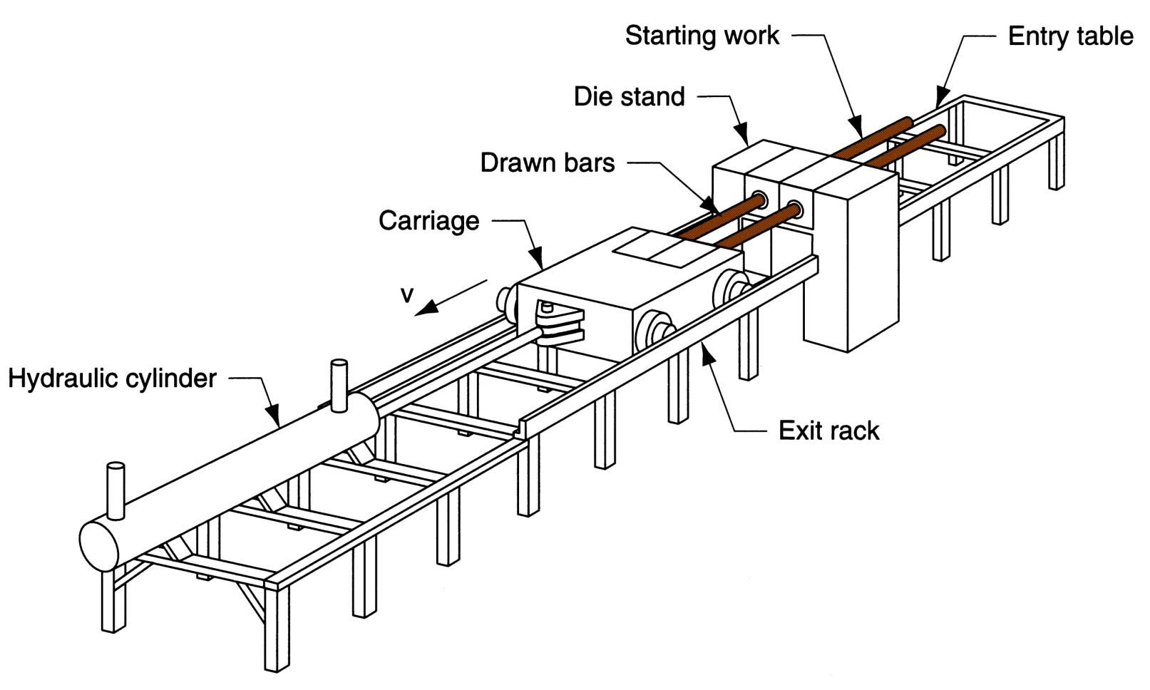
Figure 19.42 ‑ Hydraulically operated draw bench
for drawing metal bars

Slide 76
Wire Drawing
Continuous drawing machines consisting of multiple draw dies (typically 4 to 12) separated by accumulating drums
  Each drum (capstan) provides proper force to draw wire stock through upstream die
  Each die provides a small reduction, so desired total reduction is achieved by the series
  Annealing sometimes required between dies

Slide 77
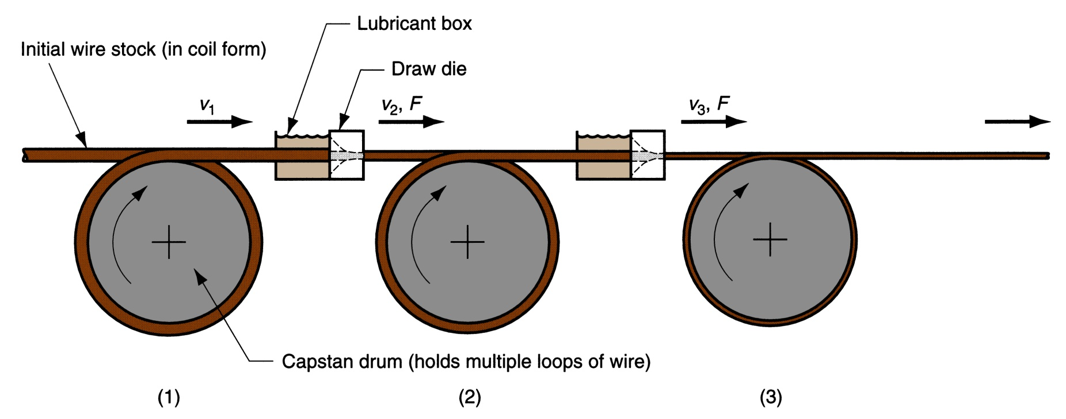
Figure 19.43 ‑ Continuous drawing of wire

Slide 78
Features of a Draw Die
Entry region - funnels lubricant into the die to prevent scoring of work and die
Approach - cone‑shaped region where drawing occurs
Bearing surface - determines final stock size
Back relief - exit zone - provided with a back relief angle (half‑angle) of about 30°
Die materials: tool steels or cemented carbides

Slide 79
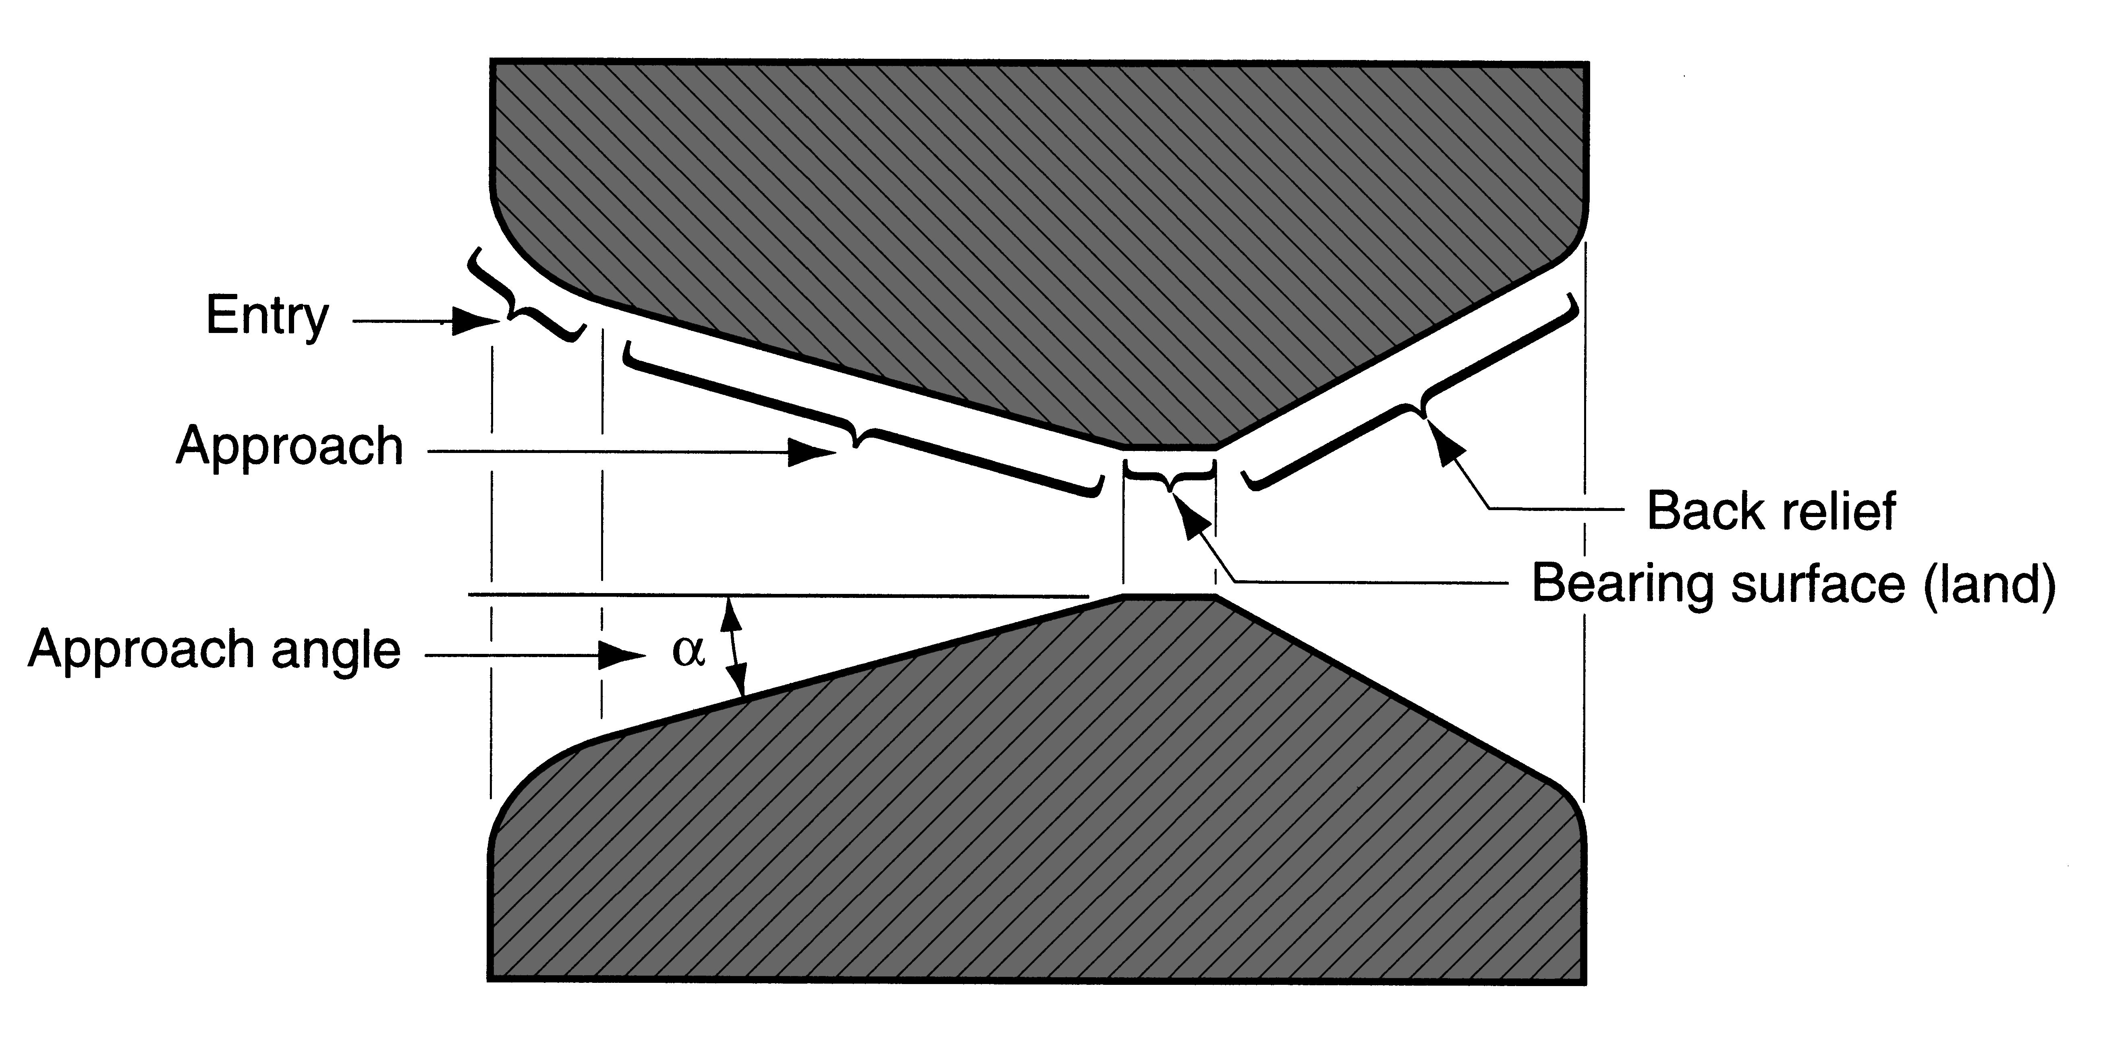
Figure 19.44 ‑ Draw die for drawing of round rod or wire

Slide 80
Preparation of the Work for
Wire or Bar Drawing
Annealing – to increase ductility of stock
Cleaning - to prevent damage to work surface and draw die
Pointing – to reduce diameter of starting end to allow insertion through draw die

